Slide 1
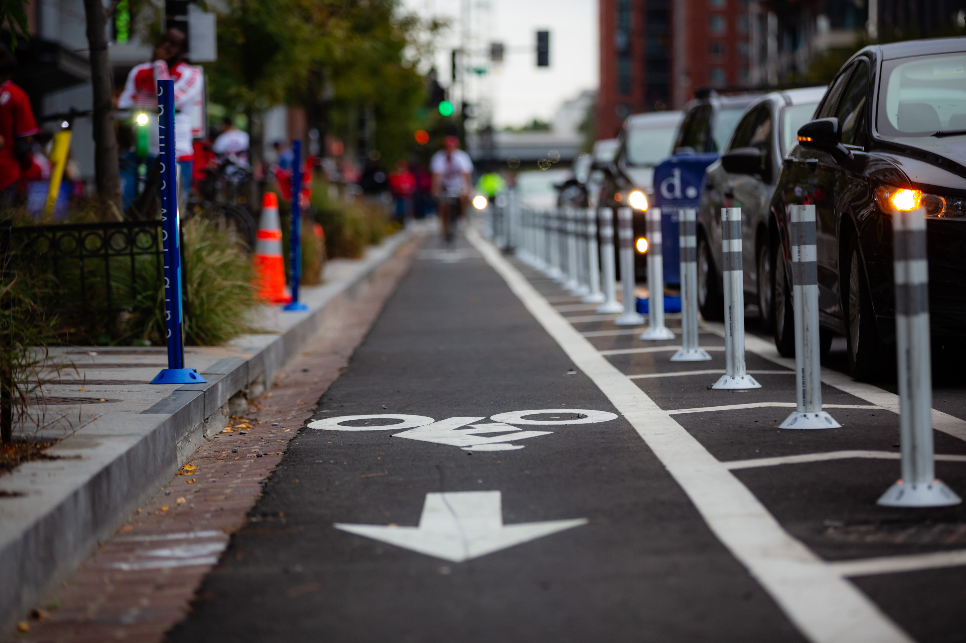
E-Bike Rebate Pitch Deck Template for Engaging with Key Partners Last Updated XX/XX/2025 If you have suggestions or comments, please contact Bryn Grunwald at bgrunwald@rmi.org

Slide 2
Pitch Deck Template Guidance
What is the purpose of this pitch deck?
To provide government staff a customizable resource when engaging with partners on an e-bike incentive program.
What does this pitch deck include?
Easily modifiable slide templates with helpful information needed to structure conversations with key e-bike incentive program partners.
How do you use this pitch deck?
Identify the story you are trying to tell and the relevant slides in this deck to help you convey that message.
Read the instruction callout in gray on each slide, update the slide contents as needed, and then delete the callout.
Update and add any content outside of the instructions to help convey your message.
Review speaker notes on each slide for talking points or additional information.
Put this presentation in your organization’s standard template (if applicable) and delete this slide before presenting.

Slide 3
[Stakeholder Type] Roles in [City/County]’s E-Bike Incentive Program [Date],[Year]
Instructions:
Remove slides 1 & 2 after reviewing
Utilize the “replace all” function to replace references to “[City/County]” with the name of your community throughout the deck.
Edit the yellow “Stakeholder Type” text to reflect the stakeholder audience.
Edit the text in “[Date], [Year]” to the date of this presentation.
Add your logo to all slides using the Slide Master.
Notes:
Photo credit: https://ddot.dc.gov/page/bicycle-lanes

Slide 4
Agenda
Local Government’s E-Bike Program Priority
Local Government’s E-Bike Program Priority
Benefits and Challenges of E-Bike Incentive Programs
Discussing Potential Partner Roles

Slide 5
[City/County]’s climate action plan prioritizes transportation electrification and mode shift
Instructions:
Edit the text in yellow to replace references to “[City/County]” with the name of your community.
Update each box with details of your community’s climate action plan — this could include specific goals or overall emissions targets that will require transportation electrification or mode shift to reach.
[City/County]’s Climate Action Plan has a goal of [reducing air pollution/reducing VMT by X% by 20XX/emissions reduction target of X% that will be aided by mode shift]
XX% of [City/County]’s greenhouse gas emissions come from transportation
[Insert graph of breakdown of miles driven by miles breakdown (e.g., 0–3 miles, 3–5 miles, 5–10 miles, etc.) if available. You can open the embedded Microsoft Excel worksheet to see what the breakdown for your city/state looks like. The breakdown of data in the spreadsheet is from Fall 2023.]

Slide 6
E-bikes are a critical transportation electrification solution and bring many local and individual benefits
Instructions:
Edit the text in yellow to replace references to “[City/County]” with the name of your community.
You can update some of the information for your city/state with the following resources:
RMI Green Upgrades Calculator
RMI E-Bike Environment and Economic Impact Assessment Calculator
State/city portal for GHG inventory, income level, etc.
Headings can be changed out depending on what data you have available and would like to highlight.
Reduce GHG Emissions | Reduce Air Pollution | Improve Physical Health | Improve Economic Outcomes
E-bikes can cut transportation emissions by [X%] E-bikes can help cut vehicle miles traveled (VMT) | X% of local air pollution is from transportation. [City/County] spent XX days at unsafe air pollution levels in 20XX. Pollution from transportation fuel combustion in [State] cause over XX premature deaths and $XX in health costs per year. Nationwide, these impacts exceeds those from coal plants. | In [State], [X%] of people do not meet minimum exercise requirements. E-bikes can help people meet exercise goals and improve physical health. | In [state], [X%] of homes currently do not have access to a personal car and [X%] live in a transit desert. In [state], switching to e-bikes for [X%] of trips could save customers [$X].
Source: RMI E-Bike Environment and Economics Impacts Assessment Calculator, 2025

Slide 7
E-bikes can help meet climate and economic goals, but need to scale
Instructions:
Read through the barriers on the slide and in the notes. Select the barriers that are most relevant for the stakeholder audience you are presenting to.
We must transition to low-carbon transportation to achieve our climate goals
For the United States to enable a 1.5°C pathway, short-distance travel must be largely electrified and decarbonized by 2050.
Many car trips are short (under 5 miles) and electrifying even a portion of them would help cut air pollution and climate emissions.
E-bikes use a fraction of the energy of electric cars and require less space and infrastructure.
E-bikes are a popular solution, but expensive and out-of-reach for many
E-bikes can have high up-front costs and can be unnerving for people who do not have much experience with biking.
Fortunately, e-bike education and incentive programs can help

Slide 8
Agenda
Local Government’s Heat Pump Priority
Local Government’s E-Bike Program Priority
Benefits and Challenges of E-Bike Incentive Programs
Discussing Potential Partner Roles

Slide 9
E-bike rebate programs seek to accelerate e-bike adoption by lowering the cost of ownership and increasing familiarity
Instructions:
Modify the slide to best fit solutions you are considering and that speak to the partner’s motivations.
These elements can help to accelerate e-bike adoption through a streamlined process
Community Outreach Educating community members about the benefits and sharing the process to participate in the program
Bike Shop Engagement
Promoting the program and providing education to participants about e-bike use and safety
Identifying Funding
Expanding access to rebates by lowering the cost of owning an e-bike
Notes:
Speakers notes
E-bike rebate programs can vary in structure, but crafting each typically requires three major components.
The first of these is providing community outreach and education. This addresses awareness and education gaps to encourage local interest in the e-bike rebate program.
The second element is engaging bike shops. Bike shops are integrated into the community and have extensive knowledge on bikes and bike safety, making them great partners for programs. Bike shops also can help share the program.
Finally, identifying funding. E-bike costs are often a barrier to ownership, but rebates for the bikes can help reduce the burden. There are many different sources of funding that can be used, from existing funds to new sources. Programs around the country use various funding types.

Slide 10
E-bike rebate programs include many benefits potentially in line with your organization’s mission
Instructions:
Edit the benefits points with aspects that relate to the mission or priority of the group you are speaking to.
Update the icons at the top as necessary to match with your selected bullet point.
Reduce vehicle miles traveled
Reduce vehicle miles traveled by encouraging mode shift from single-occupancy vehicles to e-bikes for short trips and commutes.
Improve air quality
E-bike use can reduce greenhouse gas emissions by encouraging mode shift to a lower emissions form of transportation.
Increase access to transportation
E-bikes can ensure meaningful access to mobility for low-income, BIPOC, and other underserved communities.
Improve health
E-bikes boost health through increased physical activity and improved air quality by reducing car emissions, both from fuel and reducing particulate matter.
Lower transportation
costs
E-bikes cut transportation costs by replacing cars for short trips and daily commutes, reducing fuel use and maintenance.
Notes:
Additional benefits and supplementary goals may include:
Improving access to public transit and employment centers
Supporting local bike retailers and service providers
Building the case to invest in safer infrastructure for a range of active modes

Slide 11
We are at the start of a [X–Y] month process to prepare for launching our e-bike rebate program in [month]
Instructions:
Edit the text in yellow to match the timeline for your community’s campaign.
Read through and edit the speaker’s notes.
[Start Month]
[Launch Month]
Identify the Program Team and Goals
Identify Program Funding Sources
Design Incentive Structure and Eligibility
Partner with Bike Shops
Plan Outreach Strategy and Create Materials
Launch Program
Notes:
Speakers Notes
The campaign will take XX months. The first stage, which entails identifying partners and forming the team, will take between XX and XX months. This will also include goal setting and role determination for the core team members. This will take XX months. The second step will be focused on identifying program funding sources. This will likely entail applying for grant funding or utilizing general funds. Some more alternatives include creating a dedicated mobility fee on retail purchases, partnering with utilities or reallocating already made investments. We anticipate this will take XX months.
The third step involves designing the incentive structure and eligibility to participate. There are two general options for a structure — one where participants own e-bikes and another where participants lease e-bikes. Each approach has variations and pros and cons that will need to be reviewed. We anticipate that this process will take XX months.
For the fourth step, the program team will partner with bike shops. Bike shops are crucial to the success of an e-bike rebate program because they will inform and promote the program while being trusted advisors. This step will take XX months.
The fifth step will focus on developing the campaign outreach strategy, and creating the campaign website and materials for distribution prior to launch. This step will take XX months.
Then the program will launch in in XX month

Slide 12
Agenda
Local Government’s Heat Pump Priority
Local Government’s E-Bike Program Priority
Benefits and Challenges of E-Bike Incentive Programs
Discussing Potential Partner Roles

Slide 13
There are various roles your [organization/department] could play, depending on your interest and capacity
Instructions:
Edit the text in yellow to explain your points on how the stakeholder could participate in the campaign. Update the icons as necessary.
Review the different role suggestions in the speakers notes to adjust tasks by stakeholder.
[Outreach X–Y hours/week for Z months
Conduct outreach to the prioritized communities to spread word of the campaign]
[Bike Shop Engagement X–Y hours/week for Z months
Working with bike shops to understand their interest, concerns, and participation in the program]
[Program Development X–Y hours/week for Z months
Be involved in the development of the e-bike incentive program structure, goals, planning, and implementation]
[Financial Solutions X–Y hours/week for Z months
Identify solutions to expand LMI financing solutions and identify funding sources]
Notes:
Bike advocacy groups
Help create the rebate structure
Conduct outreach
Serve as e-bike ambassadors
Conduct training for safe riding or basic bike maintenance
CBOs
Help conduct outreach to underrepresented groups
Engage with local businesses

Slide 14
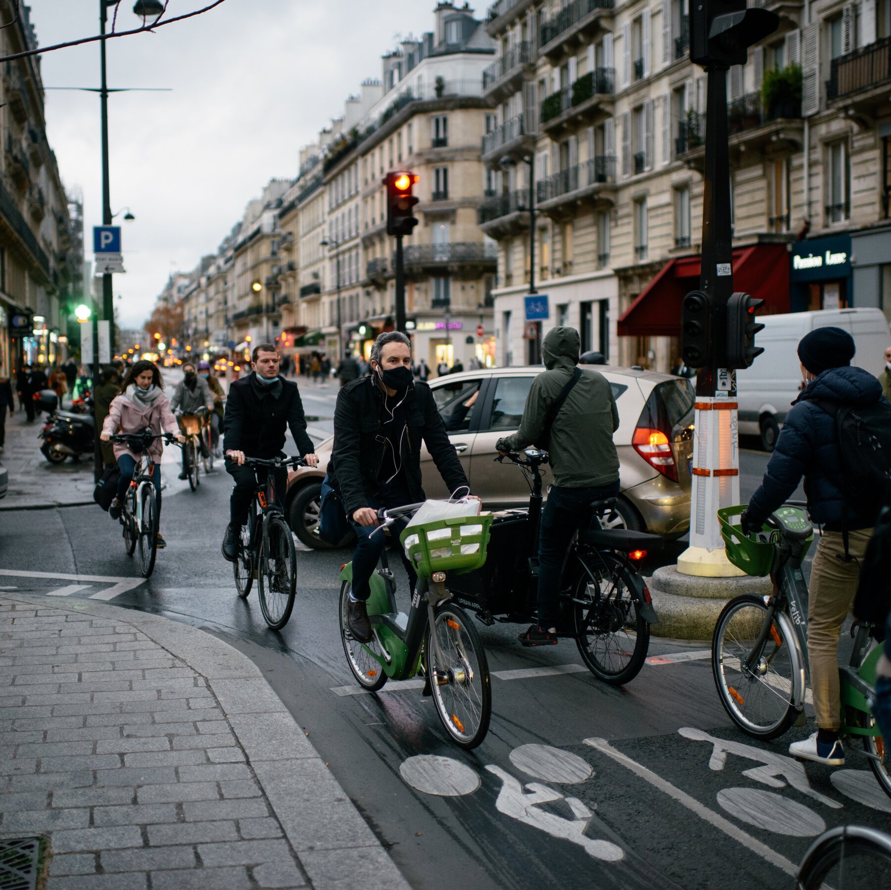
Questions?
Instructions:
Add your logo to bottom left of this slide.
Thank you!
Notes:
Photo: https://www.hgtv.com/design/remodel/mechanical-systems/heat-pump-options-and-uses

