Slide 1


ENERGY EFFICIENCY STANDARDS
FOR RESIDENTIAL RENTALS
Step 1: Set a Goal
Transforming global energy use to create a clean, prosperous, and secure low-carbon future.

Slide 2
Overview of Policy Design, Creation, and Administration

Slide 3
Setting a Goal: Metrics and Timeline
Keep the following in mind as you review the overview of the blueprint and the policy implementation timeline. You will fill out these goals after reading through the rest of the materials:
The success of the policy will be measured against the following goals:
[X jobs created]
[X increase in average HES score/HERS score/EUI/etc.]
[X% compliance rate]
[X additional efficiency programs created within X years]
[X% constituent approval]
[Annual Carbon Reduction (tons CO2)
[Annual Energy Savings (kBtu)]
[Annual Utility Bill Savings ($)]
[Cost of City to Implement Until Compliance Timeline ($)]
This policy will be implemented on the following timeline:
          Policy approval: [anticipated timeline]
          Policy launch: [anticipated timeline]
          Compliance required: [anticipated timeline]
Notes:
Forgive me for my questionable sense of humor.

Slide 4

Overview of Process for Efficiency Standards for Rentals
Rental units have had a huge impact in the affordability and sustainability of U.S. cities. It has traditionally been difficult for policymakers to target energy efficiency and equity in rental units. Cities across the U.S. now have a way to make rentals more efficient, saving energy and improving quality of life for residents through efficiency standards for rentals.

Slide 5
Assess policy fit for your city
Consider “Does your city have a rental licensing program in place?”
Yes, we have rental licensing (short- or long-term)
No, we do not have rental licensing but it is under development
No, we do not have rental licensing and do not plan to create it
Unsure
This Photo by Unknown Author is licensed under CC BY-SA
Notes:
POLL: “Does your city have a rental licensing program in place?”
Yes, we have rental licensing (short- or long-term)
No, we do not have rental licensing but it is under development
No, we do not have rental licensing and do not plan to create it
Unsure

Slide 6
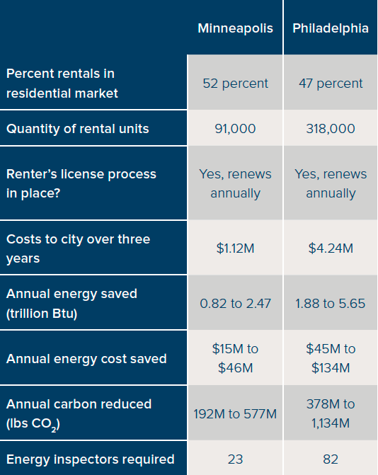
Perform a preliminary analysis to determine impact
Notes:
Specifically address / clarify the ’Costs to city’ line item

Slide 7
Consult and partner with key stakeholders in the residential housing sector
Understand and address concerns
Develop a cost recovery strategy to ensure affordability and equity
Identify compelling value propositions
Landlords /
Property Managers
Utilities
Energy Service
Industry
Notes:
This is what we’ll be covering in the next workshop

Slide 8
Co-develop financing options and incentives with utilities and lenders
PACE
Utility incentives
Utility on-bill financing
Green mortgage products
Home equity lines of credit
Green banks / credit unions

Slide 9
Develop an implementation framework
Select energy efficiency measurement tool (HES, HERS, custom)
Select energy target (balance desired savings with cost effectiveness)
Energy data collection and reporting requirements
Determine how approach varies between single family and multifamily
Determine human capital needs
Notes:
Most complex / might need two meetings

Slide 10
Develop a compliance framework
Determine compliance timeline
Create alternative compliance paths
Cost caps
Exemptions
Non-compliance penalties
Verification
Notes:
Try to add an image

Slide 11

Develop a disclosure framework
Option 1: Create public database of rentals showing whether they are in compliance, non-compliant, or exempt
Option 2: Require disclosure of energy score to renter before signing lease
Option 3: Incorporate energy score into local MLS and rental platforms

Slide 12
Policy Blueprint

Slide 13
The Intent of a Policy Blueprint
An internal document intended to inform and clarify the policy being implemented and the actions required.
Something tangible you can use to engage with stakeholders, draft the policy, and plan for future monitoring and evaluation.
The Goal
Local Context
Policy Parameters
Preliminary Impact Calculation
Identify Stakeholders
Notes:
Everyone read the pre-read, right?
NOT an energy roadmap or climate action plan– but similar

Slide 14

Section 1: The Goal
[City] will implement efficiency standards for residential rentals by [timeline] with compliance required by [timeline]. This policy will [help us achieve our climate action goals / reduce the energy burden for renters / improve the city’s existing building stock / create local jobs / improve comfort for renters / increase value of rental properties / address efficiency in existing buildings].
This Photo by Unknown Author is licensed under CC BY-SA
Notes:
Forgive me for my questionable sense of humor.

Slide 15

Section 2: Local Context
Existing Policies and Financing Tools
State of Rental Housing Market
Supporting Resources
Stakeholder Priorities
Notes:
These items can give important insight that informs optimal policies
Note that in CA’s “New Residential Zero Net Energy Action Plan 2015-2020”, the Policy Context chapter is almost as long as entire action plan
Existing Policies:
May include existing Climate Action Plans or Energy Roadmaps, state legislation enabling community solar or PACE financing, and utility incentive programs.
Supporting Resources
Doing this in workshop 5!
State of Housing Market
Housing market strength: Zillow, Redfin can provide free data
Labor availability
Affordability issues
Stakeholder Priorities
Covered in workshop 2!
Needs, wants, priorities

Slide 16
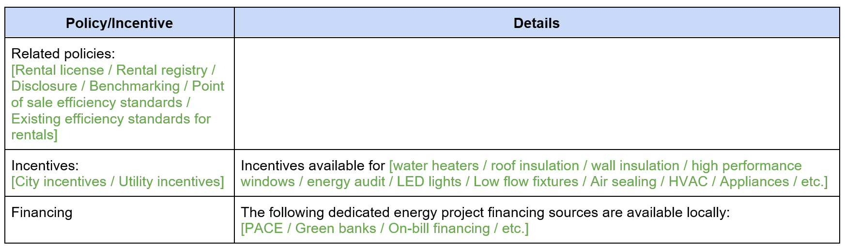
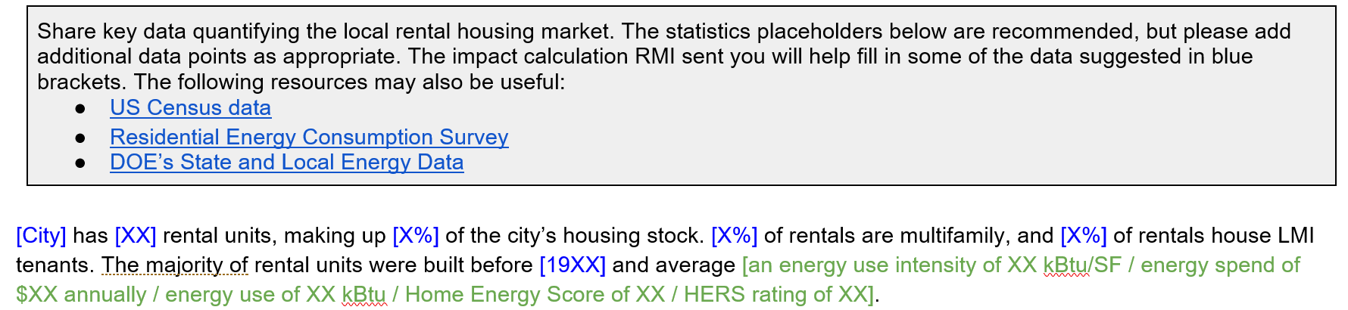
Section 2: Local Context
Existing Policies and Financing Tools
State of Rental Housing Market

Slide 17
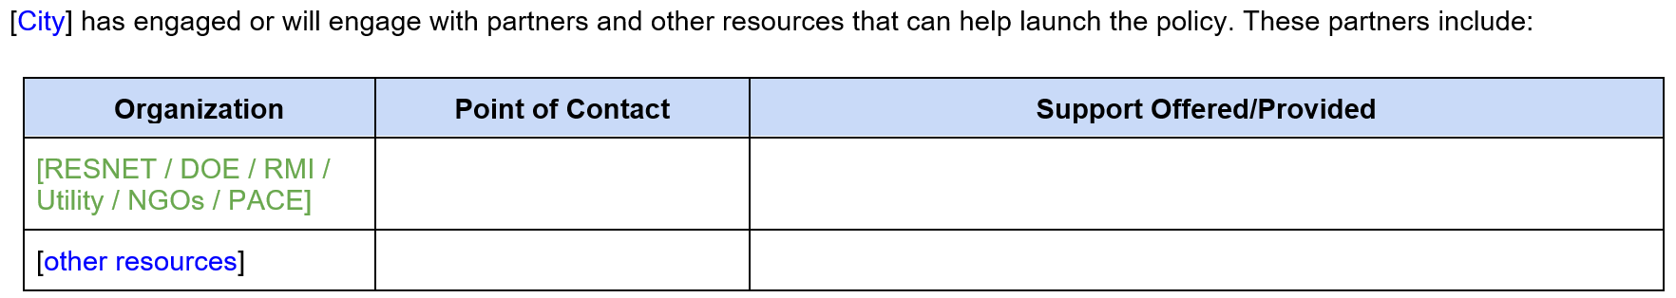
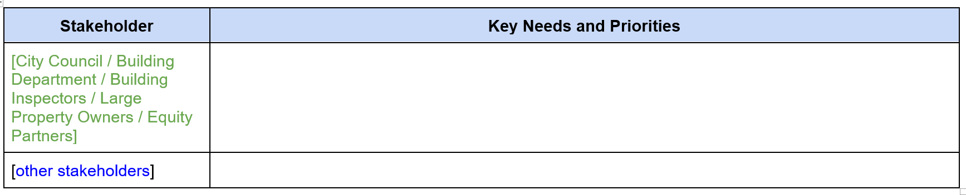
Section 2: Local Context
Supporting Resources
Stakeholder Priorities
Use Stakeholder Mapping Tool

Slide 18

Section 3: Policy Components
Fit
Implementation
Compliance
Disclosure
Affordability
This Photo by Unknown Author is licensed under CC BY-NC-ND
Notes:
These items can give important insight that informs optimal policies
Note that in CA’s “New Residential Zero Net Energy Action Plan 2015-2020”, the Policy Context chapter is almost as long as entire action plan
Existing Policies:
May include existing Climate Action Plans or Energy Roadmaps, state legislation enabling community solar or PACE financing, and utility incentive programs.
Supporting Resources
Doing this in workshop 5!
State of Housing Market
Housing market strength: Zillow, Redfin can provide free data
Labor availability
Affordability issues
Stakeholder Priorities
Covered in workshop 2!
Needs, wants, priorities

Slide 19

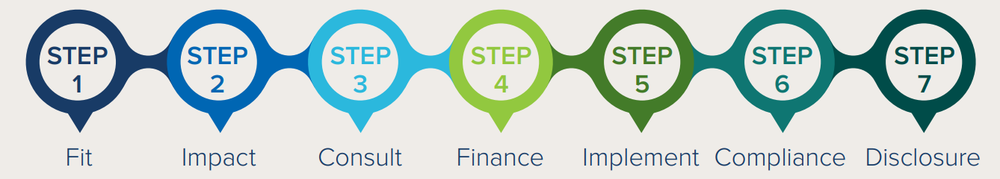

Section 3: Policy Components
Available Free Online:
https://www.rmi.org/wp-content/uploads/2018/05/Better-Rentals-Better-City_Final3.pdf
Notes:
Clarify what we mean – launching vs taking effect / phasing in requirements

Slide 20
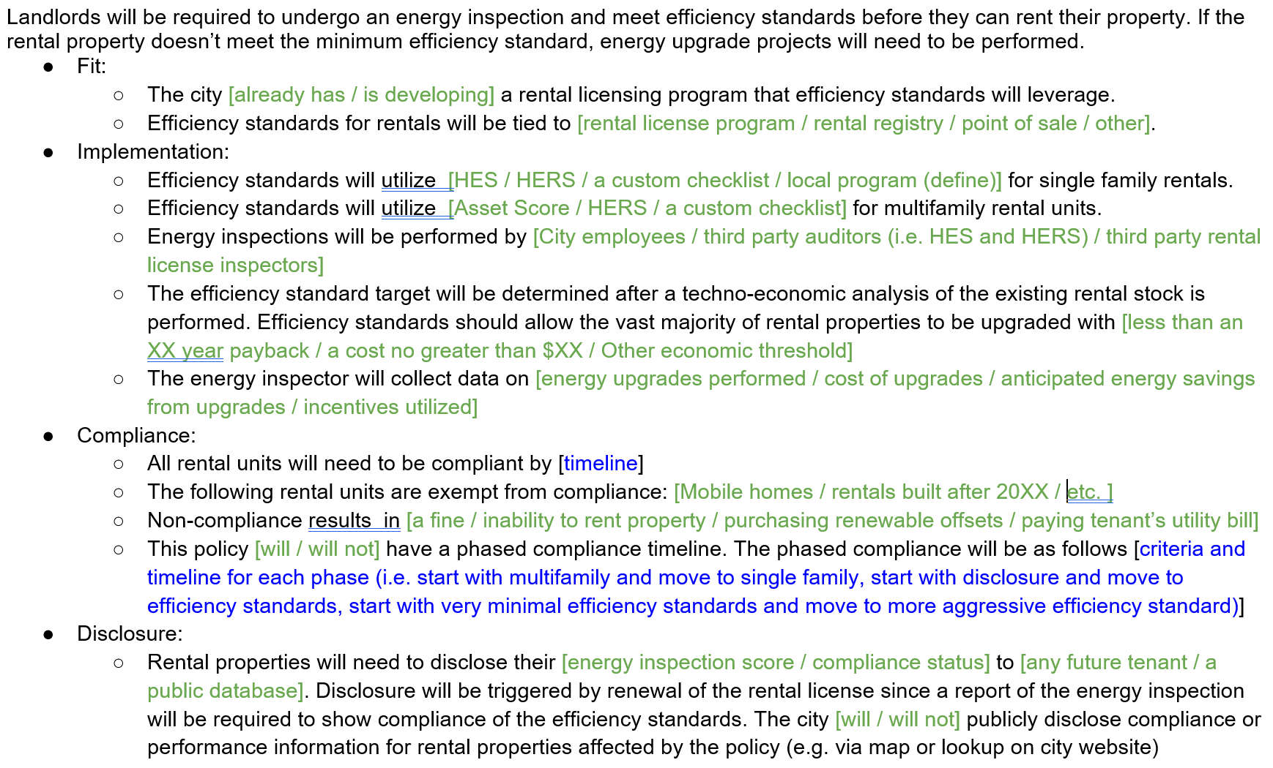
Section 3: Policy Components
This Photo by Unknown Author is licensed under CC BY-NC-ND
Notes:
These items can give important insight that informs optimal policies
Note that in CA’s “New Residential Zero Net Energy Action Plan 2015-2020”, the Policy Context chapter is almost as long as entire action plan
Existing Policies:
May include existing Climate Action Plans or Energy Roadmaps, state legislation enabling community solar or PACE financing, and utility incentive programs.
Supporting Resources
Doing this in workshop 5!
State of Housing Market
Housing market strength: Zillow, Redfin can provide free data
Labor availability
Affordability issues
Stakeholder Priorities
Covered in workshop 2!
Needs, wants, priorities

Slide 21
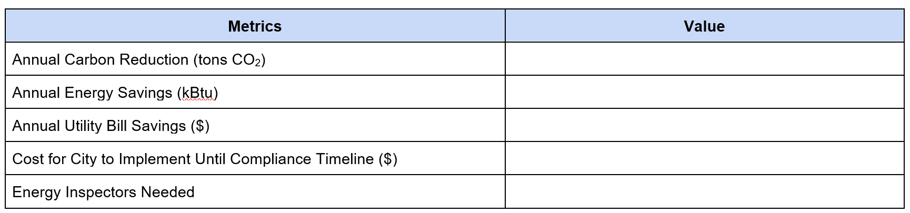
Section 4: Preliminary Impact Calculation
Use Impact Calculator Tool
This Photo by Unknown Author is licensed under CC BY-NC-ND
Notes:
These items can give important insight that informs optimal policies
Note that in CA’s “New Residential Zero Net Energy Action Plan 2015-2020”, the Policy Context chapter is almost as long as entire action plan
Existing Policies:
May include existing Climate Action Plans or Energy Roadmaps, state legislation enabling community solar or PACE financing, and utility incentive programs.
Supporting Resources
Doing this in workshop 5!
State of Housing Market
Housing market strength: Zillow, Redfin can provide free data
Labor availability
Affordability issues
Stakeholder Priorities
Covered in workshop 2!
Needs, wants, priorities

Slide 22
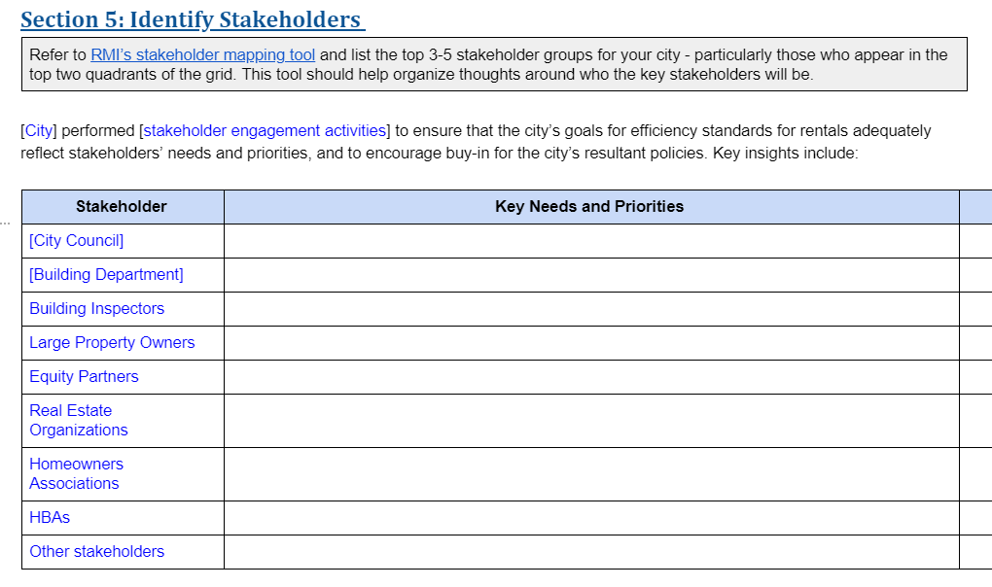
Section 5: Identify Stakeholders

Slide 23
Setting a Goal

Slide 24
Section 1: The Goal
[City] will implement efficiency standards for residential rentals by [timeline] with compliance required by [timeline]. This policy will [help us achieve our climate action goals / reduce the energy burden for renters / improve the city’s existing building stock / create local jobs / improve comfort for renters / increase value of rental properties / address efficiency in existing buildings].
This Photo by Unknown Author is licensed under CC BY-SA
Notes:
Forgive me for my questionable sense of humor.

Slide 25
Setting a Goal: Metrics and Timeline
Now that you have an overview of the policy blueprint and considerations for passing the policy, consider which of the metrics align with your city's larger environmental goals:
The success of the policy will be measured against the following goals:
[X jobs created]
[X increase in average HES score/HERS score/EUI/etc.]
[X% compliance rate]
[X additional efficiency programs created within X years]
[X% constituent approval]
[Annual Carbon Reduction (tons CO2)
[Annual Energy Savings (kBtu)]
[Annual Utility Bill Savings ($)]
[Cost of City to Implement Until Compliance Timeline ($)]
This policy will be implemented on the following timeline:
          Policy approval: [anticipated timeline]
          Policy launch: [anticipated timeline]
          Compliance required: [anticipated timeline]
This Photo by Unknown Author is licensed under CC BY-SA
Notes:
Forgive me for my questionable sense of humor.

