Slide 1


ENERGY EFFICIENCY STANDARDS
FOR RESIDENTIAL RENTALS
Step 5: Engage Stakeholders
Transforming global energy use to create a clean, prosperous, and secure low-carbon future.

Slide 2
Consult and partner with key stakeholders
Identify key stakeholders and determine outreach channels
Identify compelling value propositions
Develop a cost recovery strategy to ensure affordability and equity
Large Property
Owners
Internal City Stakeholders
Small Property Owners
Notes:
Jacob run

Slide 3
Additional Stakeholder Engagement Resources
Topic | Key Resources
Stakeholder Groups | The Zero Energy Project synthesizes information and resources to support conversations with builders, designers, realtors, and homeowners. NREL’s DER Benefits Analysis Studies report summarizes existing research quantifying the cost/benefit of distributed energy resources to utilities.
Administrative Resources | NBI’s ZNE Design Charrette Toolkit provides a number of useful template emails, workshop itineraries, and more NRCAN’s Stakeholder Engagement Guide provides an overview of seven key stakeholder groups and a set of worksheets for engagement. IAP2’s Public Participation Spectrum provides a useful framework for varying levels of public engagement.
Facilitation Theory | Ingrid Bens’ Facilitation at a Glance pocket guide provides an overview of facilitation theory and key techniques used to drive successful engagement. Adam Kahane’s Collaborating with the Enemy is an excellent read.
Notes:
NBI’s resource is geared toward new building design, but still a useful reference
NRCAN’s resource is geared toward district energy topics, but still a useful reference
RAISE YOUR HANDS: anything to add?

Slide 4
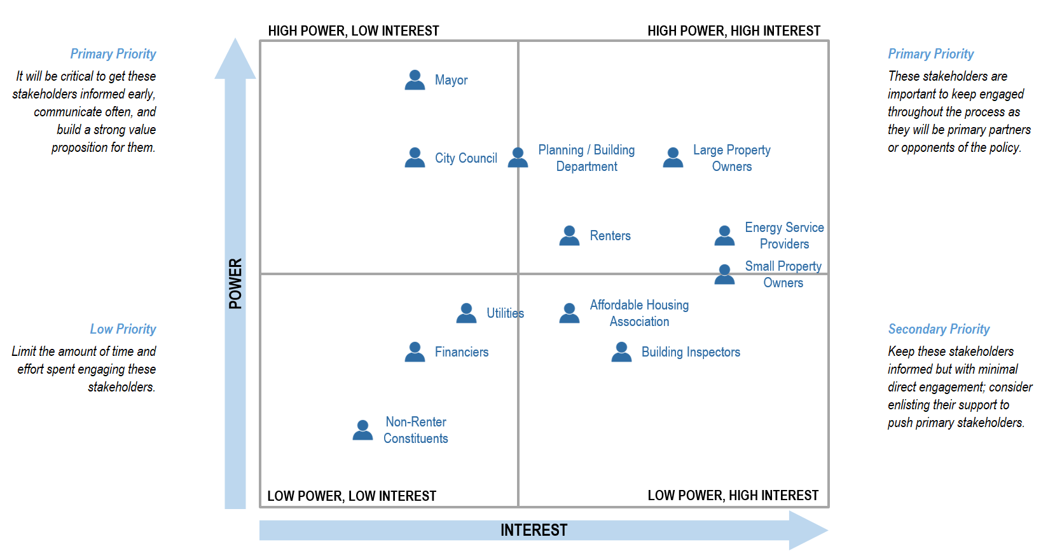
Stakeholder mapping tool overview
Notes:
Jacob. Open up for questions about how to use the tool and how to engage a specific stakeholder.

Slide 5
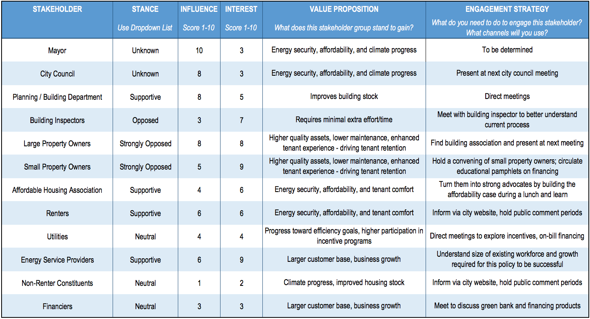
Stakeholder mapping tool overview
Notes:
Jacob run. Go through a view stakeholders and give an example of a value prop and next step

