Slide 1


ENERGY EFFICIENCY STANDARDS
FOR RESIDENTIAL RENTALS
2. Identify Local Context
Transforming global energy use to create a clean, prosperous, and secure low-carbon future.

Slide 2

Section 2: Local Context
Existing Policies
State of Rental Housing Market
Identifying Capital Resources
Notes:
These items can give important insight that informs optimal policies
Note that in CA’s “New Residential Zero Net Energy Action Plan 2015-2020”, the Policy Context chapter is almost as long as entire action plan
Existing Policies:
May include existing Climate Action Plans or Energy Roadmaps, state legislation enabling community solar or PACE financing, and utility incentive programs.
Supporting Resources
Doing this in workshop 5!
State of Housing Market
Housing market strength: Zillow, Redfin can provide free data
Labor availability
Affordability issues
Stakeholder Priorities
Covered in workshop 2!
Needs, wants, priorities

Slide 3
Existing Policies and State of Rental Housing

Slide 4
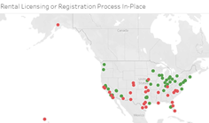
Check if your city has a rental licensing policy in place
1.Rentals make up at least 30 percent of your city’s residential properties, and
2.You have a long-term rental licensing program already in place. If this is not the case, consider alternatives such as integrating efficiency standards into short-term rental licensing, starting a new rental licensing program in the city, and considering other triggers, such as upgrades at time of sale, to improve efficiency of existing residential properties.
See RMI Map Cities with Rental Licensing
Note : This is based off of preliminary research, and cities may have updated policies. Please let us know if you like us to update this map for your city.

Slide 5

Existing Incentives
Consider city and utility incentives
The DSIRE database has a list of city and state policies: Database of State Incentives for Renewables and Efficiency
  Assess legal regulations and supporting policies

Slide 6
Identifying Capital Resources

Slide 7
City Program Funding Options
Refocus Existing Funds
  Reprioritize existing staff to this initiative
  CDBG funds
  Weatherization funds
Grants
  State or federal government
  Foundation
  Corporate giving
Public-Private Partnerships
  Retail or manufacturer sponsor
  CRS campaign
  Healthcare home-services program
Self-Sustaining Fees
  Licensing fees
  Utility surcharge
  Non-compliance or alternative compliance fees
Taxes
  Carbon tax
  Millage
Notes:
Jacob Run. Go to poll

Slide 8
Co-develop financing options for building owners
PACE
Utility incentives
Utility on-bill financing
Green mortgage products
Home equity lines of credit
Green banks / credit unions

Slide 9
Overview of Property Assessed Clean Energy (PACE)
What: PACE allows a property owner to finance the up-front cost of an energy efficiency or renewable energy project and then pay the costs back over time through a voluntary assessment.
Benefits:
Offers 100% financing
Spreads payments over life of the product
Assessment is attached to the property rather than an individual.
Allows for transferability creating for more certainty of financial recapture at resale
Addressing multi-party split incentives
Best Fit: In states were PACE programs already exist or PACE is enabled.
Notes:
Connect the Dots:
--Up front cost
--Transferability
--Property values

Slide 10
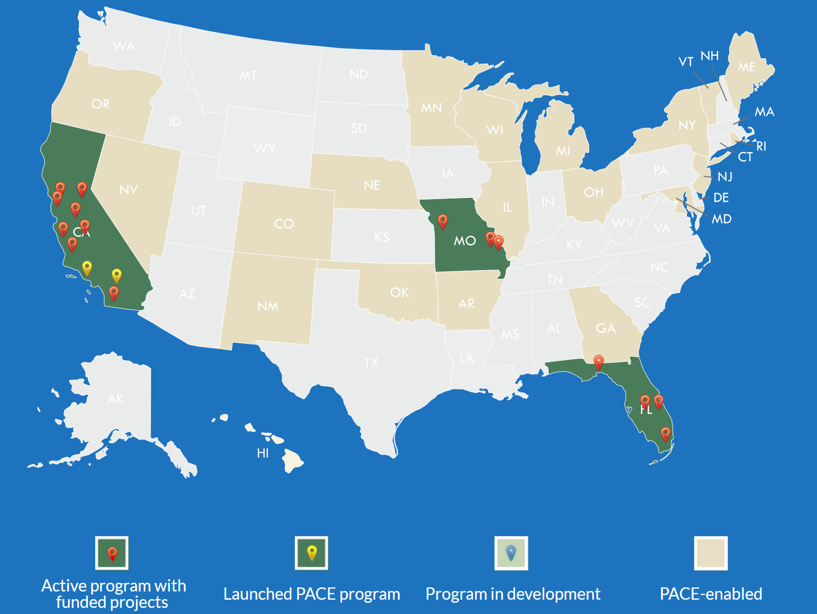
Residential Property Assessed Clean Energy (R-PACE)
Applicable for buildings with 1-4 living units
Source: PACENation
Notes:
CO and NY are actively pursing residential program
Massachusetts, Washington, Texas, Kansas, north Carolina, Virginia, Connecticut – no pace enabled

Slide 11
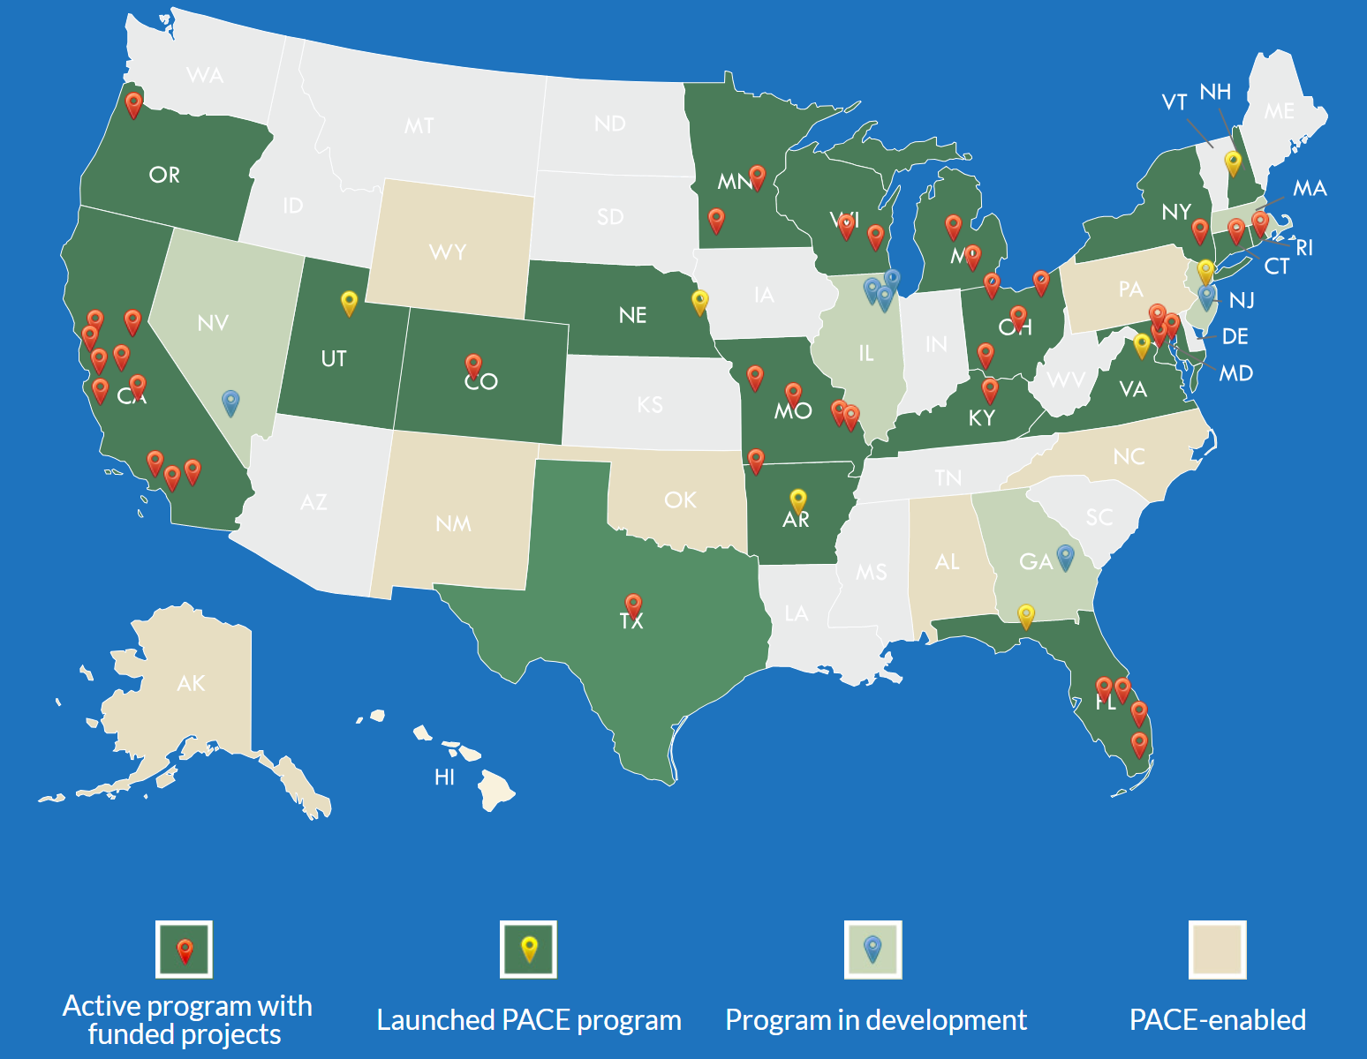
Commercial Property Assessed Clean Energy (C-PACE)
Applicable for buildings with 5+ living units
Source: PACENation
Notes:
Massachusetts, Washington, Kansas– no pace enabled

Slide 12
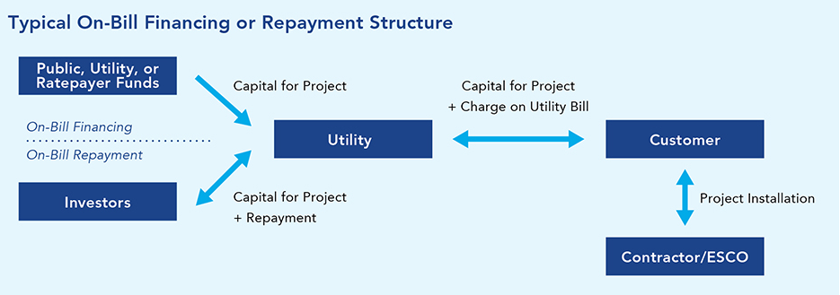
Overview of On-Bill Financing/Repayment
Source: US DOE Better Buildings
Benefits:
Savings are paired directly with repayment on the same utility bill
Spreads out the cost of the improvement over time
Resolves split incentive issue
Default rates is below 3%
Best Fit: Municipal Utility
Notes:
Resource to share: https://aceee.org/sector/state-policy/toolkit/on-bill-financing
Could require “bill-neutrality” meaning energy efficiency savings on monthly bills must be greater or equal to a customers loan payment
Can tie debt to the meter, not the customer, so the benefits and the debt stay with a property when a renter moves.
On-bill financing programs can be arranged to use utility bill repayment history to underwrite upgrades, allowing customers with poorer credit scores to access financing

Slide 13
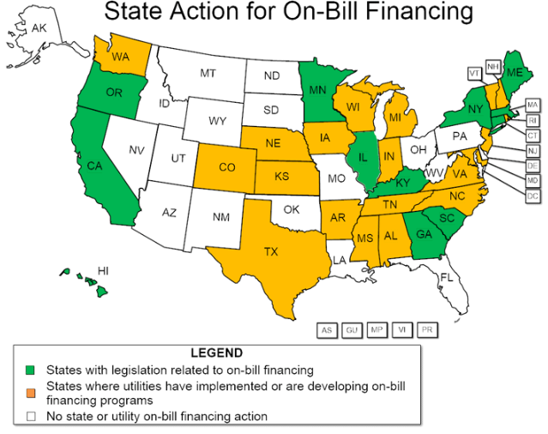
State Action for On-Bill Financing
Notes:
Jacob – Fort Collins

Slide 14
Overview of Green Banks and Revolving Loan Fund
What: Uses public dollars to leverage private investment capital dedicated to low carbon, climate resilient infrastructure.
Benefits:
Lower energy costs
Preserving public capital
Increased leverage
Driving private investment
Economic development and job creation
Best Fit: Existing program or source of capital available
Notes:
Resource to share: https://aceee.org/sector/state-policy/toolkit/on-bill-financing

Slide 15
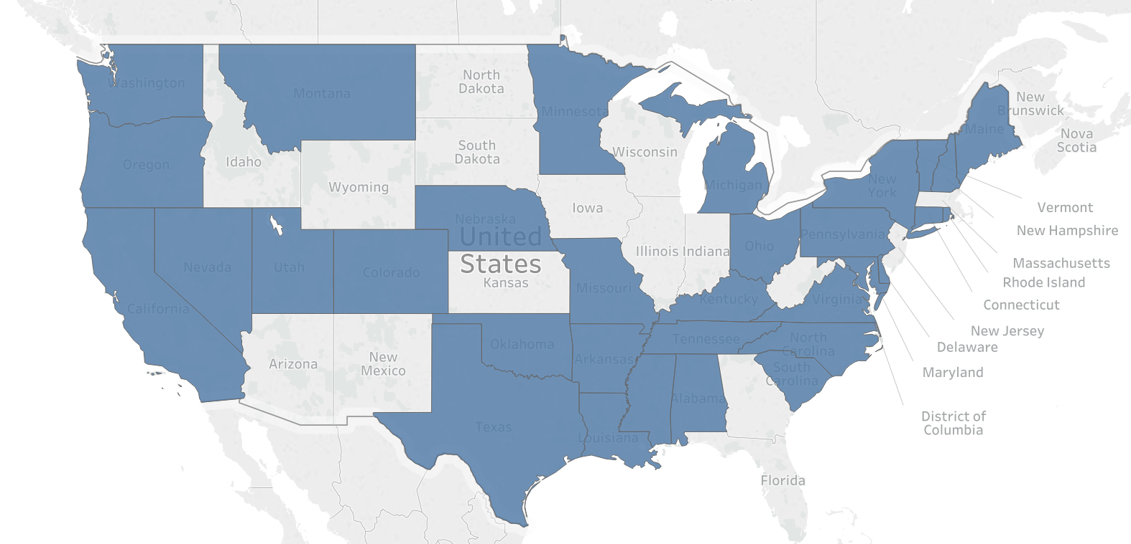
Where are green banks and/or revolving loan funds available?
Legend
States with a green bank and/or a
revolving loan fund
Notes:
Update using this: https://spotforcleanenergy.org/state/california/on_bill-financing-/-on_bill-repayment/

Slide 16

Green Mortgage Products Available Nationally
Fannie Mae Homestyle Energy Loans:
Eligible: 1-4 unit existing properties
Finance amount: up to 15 percent of appraised property value
Requirement: HERS or HES report
Fannie Mae Green Rewards:
Eligible: Multifamily
Finance amount: up to 5 percent more than a conventional loan
Additional benefits: Energy and water audit report paid by Fannie Mae
Requirement: 25% reduction in annual energy use
Term: 5 to 30 years

Slide 17
Financing available through local lenders
Home Equity Line of Credit (HELOC): Similar to having a credit card where your credit limit is based on the amount of equity in your home.
Home Equity Loan: Lump-sum loan with set term, fixed interest rate and set payment schedule using home as collateral.
Local credit unions may offer efficiency loans: varies, but typically lump sum with set term.

Slide 18
How do you think you’ll fund this work?
(choose 2)
Refocus existing funds
Grants
Public private partnership
Self-sustaining fee
Taxes
Notes:
Jacob Run. Go to poll

Slide 19
How will this policy impact affordability?
Landlord Protected Financially
Market Rate
Affordable for All
LIHTC,
Rent Controlled
Tenant Financial Risk
Tenant Protected Financially
Landlord Financial Risk
Notes:
Alisa run

