Slide 1
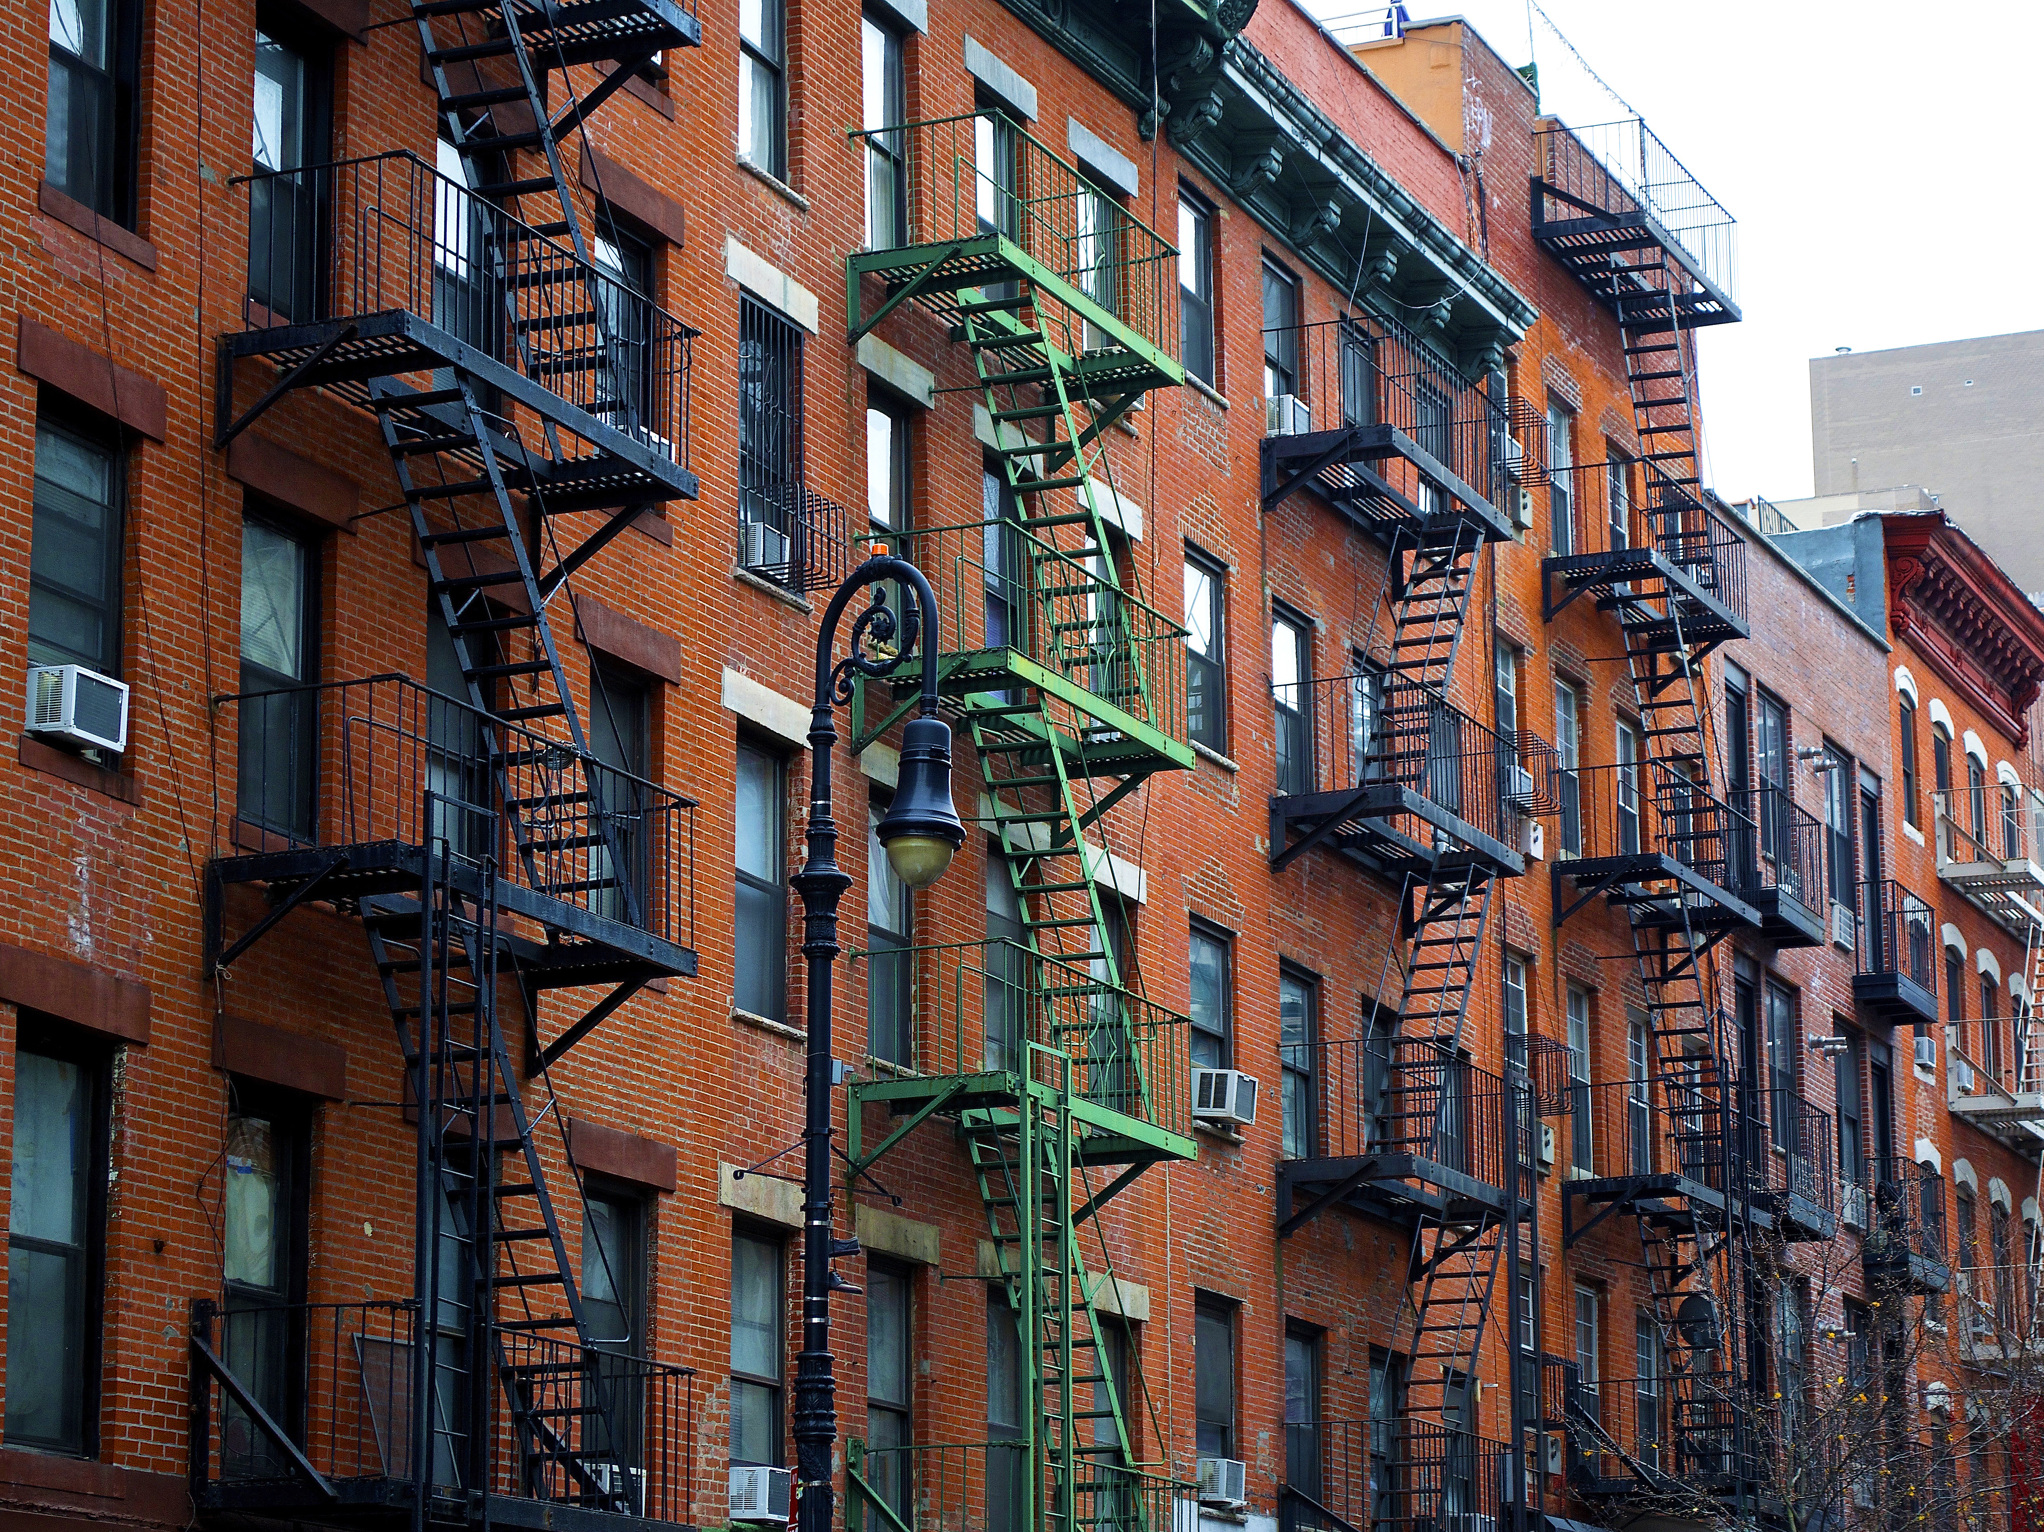

ENERGY EFFICIENCY STANDARDS
FOR RESIDENTIAL RENTALS
3. Choose Policy Parameters
Transforming global energy use to create a clean, prosperous, and secure low-carbon future.

Slide 2

Section 3: Policy Components
Fit
Implementation
Compliance
Disclosure
Affordability
This Photo by Unknown Author is licensed under CC BY-NC-ND
Notes:
These items can give important insight that informs optimal policies
Note that in CA’s “New Residential Zero Net Energy Action Plan 2015-2020”, the Policy Context chapter is almost as long as entire action plan
Existing Policies:
May include existing Climate Action Plans or Energy Roadmaps, state legislation enabling community solar or PACE financing, and utility incentive programs.
Supporting Resources
Doing this in workshop 5!
State of Housing Market
Housing market strength: Zillow, Redfin can provide free data
Labor availability
Affordability issues
Stakeholder Priorities
Covered in workshop 2!
Needs, wants, priorities

Slide 3
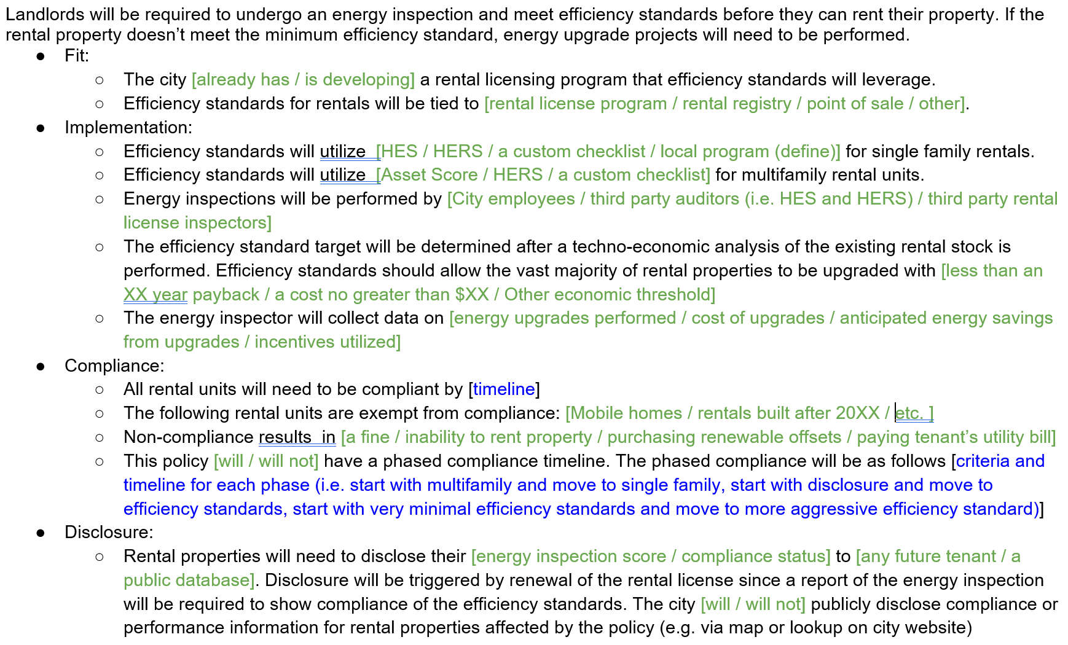
Section 3: Policy Components
This Photo by Unknown Author is licensed under CC BY-NC-ND
Notes:
These items can give important insight that informs optimal policies
Note that in CA’s “New Residential Zero Net Energy Action Plan 2015-2020”, the Policy Context chapter is almost as long as entire action plan
Existing Policies:
May include existing Climate Action Plans or Energy Roadmaps, state legislation enabling community solar or PACE financing, and utility incentive programs.
Supporting Resources
Doing this in workshop 5!
State of Housing Market
Housing market strength: Zillow, Redfin can provide free data
Labor availability
Affordability issues
Stakeholder Priorities
Covered in workshop 2!
Needs, wants, priorities

Slide 4
Fit and Implementation

Slide 5
Develop an implementation framework
Select energy efficiency measurement tool (HES, HERS, custom)
Select energy target (balance desired savings with cost effectiveness)
Energy data collection and reporting requirements
Determine how approach varies between single family and multifamily
Determine human capital needs
Notes:
Most complex / might need two meetings

Slide 6
Overview of Implementation Tools
HES
Tool and training already developed by respected 3rd party (DOE)
HERS
Tool and training already developed by respected 3rd party (RESNET)
Higher cost and time commitment audit ($450 three hours)
Custom Checklist
Tool and training would need to be developed by city
Low cost and time commitment audit ($175 one hour)
Suggested ECMs and associated savings are tailored to home
Only available for single family homes
Shows how score is impacted if all suggested ECMs are implemented, but somewhat of a black box
Suggested ECMs and associated savings are tailored to home
Available for both single family and multifamily
Shows how score is impacted if individual ECMs are implemented
Somewhat of a black box
Can be designed to keep cost and time commitment down
Could work for both single family and multifamily
Very transparent how ECMs impact score
ECM points not tailored for specific homes
HES
Notes:
Elizabeth

Slide 7
What is the most important criteria in your city when selecting an implementation tool?
Time/cost requirement for city
Cost of audit
Ability to serve both single family and multifamily
Transparency of tool
Accuracy of tool

Slide 8
What implementation tool are you leaning towards using?
HES
HERS
Custom Checklist
Other
Notes:
Open discussion on this. How familiar are you with these tools? What additional information about these tools do you need to know to be comfortable moving forward?

Slide 9

How many efficiency inspectors are needed?
RMI included this number in each of the city’s impact calculations. Here were our assumptions:
Took the total number of non-exempt rentals
Made an assumption of how much notice city will give landlords to become compliant (3 yrs)
Assume efficiency inspections are spread out evenly across those years
Assumed each full time inspector could do 1,040 inspections a year

Slide 10
Who are the efficiency inspectors?
City Employee
More control
Rental License Inspector (City Employee)
Secure workforce
Rental License Inspector (3rd party)
Minimal city cost
Workforce development required
Third Party Contractor
Secure workforce
City salary
Might be outside their specialty
Add capacity, but not an entirely new workforce that needs to be created
City salary
Inspectors can choose to opt-in or out of this additional designation
Minimal city cost
Workforce development required
Knows how to work within the system already in place
Have building science background
Builds local small businesses
Notes:
We were thinking about the rental licence inspectors being 3rd party contractors, but others we’ve spoken with have been thinking about them as city employees. Here are our pros and cons. What additional considerations should we be thinking about?
Open discussion: What are some ideas for building out this workforce?

Slide 11
Consult and partner with key stakeholders in the residential housing sector
Understand and address concerns
Develop a cost recovery strategy to ensure affordability and equity
Identify compelling value propositions
Landlords /
Property Managers
Utilities
Energy Service
Industry
Notes:
This is what we’ll be covering in the next workshop

Slide 12
Compliance

Slide 13
Develop a compliance framework
Determine compliance timeline
Create alternative compliance paths
Cost caps
Exemptions
Non-compliance penalties
Verification
Notes:
Try to add an image

Slide 14

Discussion on Selecting an Energy Target
What’s the baseline and current distribution of energy scores in your city? How could you determine that?
      SLED per household (city specific data in impact calculation RMI sent)
      Do energy audits on a sample of homes to determine baseline
      Use AEMs
What cost threshold do you care about? Do landlords think it terms of X% of total rent, total dollar amount, or simple payback? How do you determine what is a reasonable cost burden to put on landlords?
How much money would it take for the average home to get to the target score? How could this be estimated?
This Photo by Unknown Author is licensed under CC BY-ND
Notes:
Open discussion around these topics

Slide 15
Is Phased Compliance a Good Idea?
+
Could result in faster impact
-
Results in lower immediate impact numbers
Gives more time to work on more complicated issues
Drags out battles
Work out kinks along the way
Policy may be vulnerable with changing political parties
Results in more cost effective upgrades
HES
Notes:
Question: What phased approaches are you considering? What will this help address?

Slide 16
Phased Compliance Ideas
Option #1
Phase 1: Require energy inspection and disclosure but no efficiency standard
Option #2
Phase 1: Require short term rentals to meet efficiency standard
Option #3
Phase 2: Require basic efficiency standards for all rentals
Phase 2: Require long term rentals to meet efficiency standards
Phase 3: Gradually improve efficiency requirement over time
Phase 1: Require multifamily rentals over a certain size to meet efficiency standards
Phase 2: Gradually lower size requirement until all rentals are compliance
HES
Notes:
Question: What phased approaches are you considering? What will this help address?

Slide 17
How can cities help with cost effective compliance?
Alternative Compliance
Cost Cap
Exemptions
Notes:
Question: What phased approaches are you considering? What will this help address?

Slide 18
How can cities help with cost effective compliance?
Alternative Compliance
Reason:
This allows landlords that can’t achieve efficiency standard to still work toward the essence of this policy (affordability and climate change)
Example:
If ultimate goal is affordability, landlord has to pay tenant’s utility bill (without raising rent).
If ultimate goal is climate change, pay fine that goes towards CAP
Questions to Tackle:
How can we develop alternative compliance paths that are useful but not so compelling that no one pursues the policy?
How can cities ensure landlords aren’t raising rent to pay for their alterative compliance options?
Notes:
Question: What phased approaches are you considering? What will this help address?

Slide 19
How can cities help with cost effective compliance?
Cost Cap
Reason:
This ensures rental owners aren’t breaking the bank trying to meeting efficiency standards they’re unable to achieve.
Example:
Projects need to pay back in X years or less based on energy savings.
Projects can only cost XX.
Projects can only be X% of rental revenue.
Questions to Tackle:
How can cities ensure property owners are selecting the most cost effective upgrades? (I.e. if a landlord is looking at replacing their windows they may hit the cost cap and think they’re not required to do anything.)
What is a reasonable cost cap?
Notes:
Question: What phased approaches are you considering? What will this help address?

Slide 20
How can cities help with cost effective compliance?
Rentals built after 2000
Exemptions
Reason:
This ensures cities aren’t spending time and resources on properties that they already know are compliant.
Example:
Properties that have already achieved energy related certification (ZERH)
Question to Tackle:
Beyond properties that cities should assume are already compliant, what other exemptions should be considered?
Notes:
Question: What phased approaches are you considering? What will this help address?

Slide 21
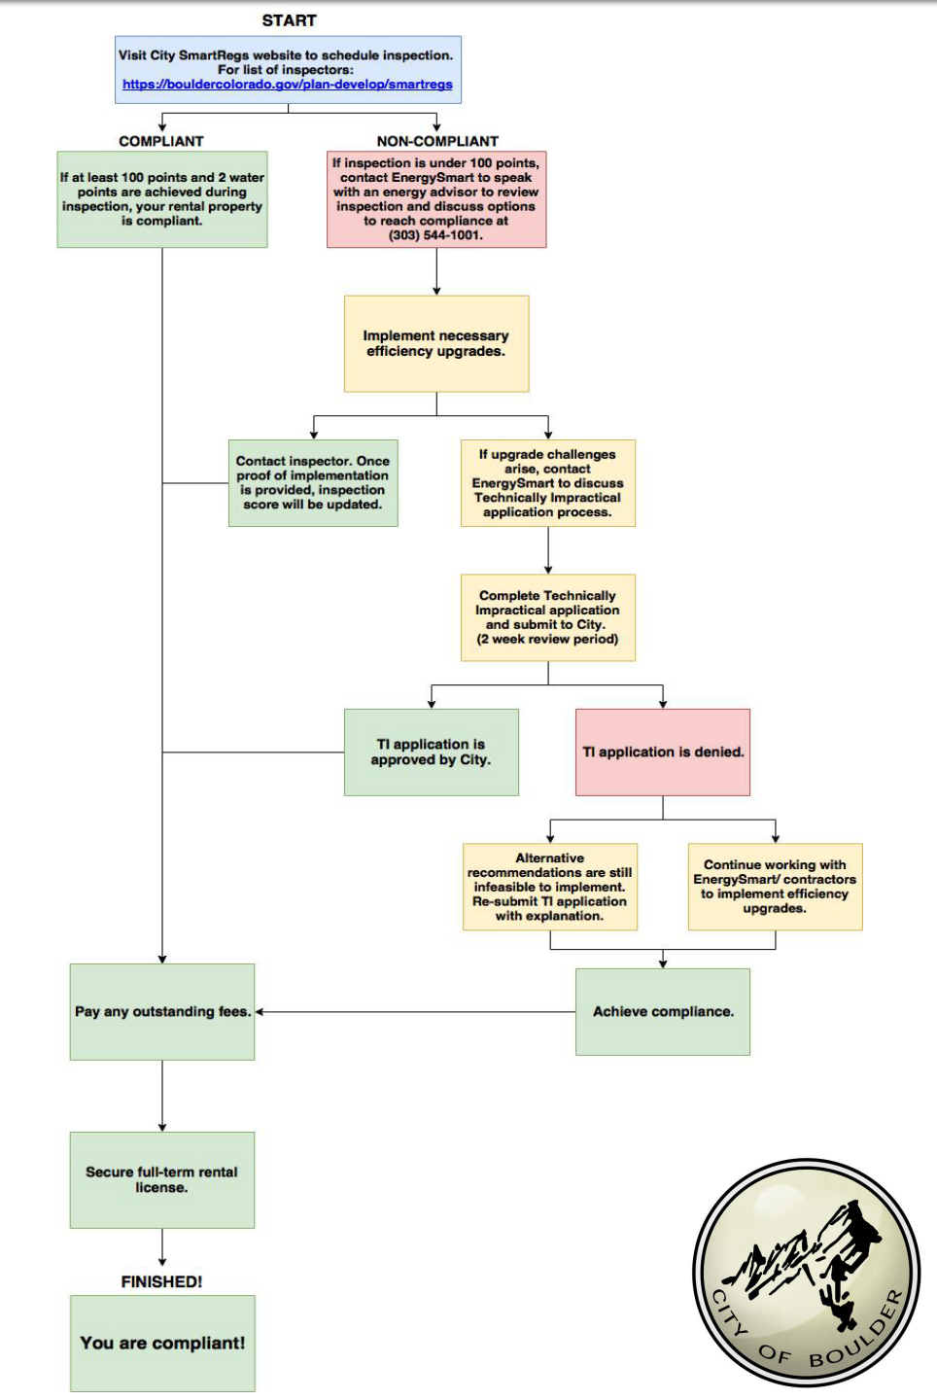
Boulder’s Compliance Flowchart
Resource here: https://www-static.bouldercolorado.gov/docs/SmartRegs_Compliance_Process_Flowchart_3_2018-1-201803190953.pdf?_ga=2.233871197.2113064351.1537852761-1102657128.1515087092

Slide 22

Enforcement
How is compliance checked?
            Boulder’s Example: Every 4 years rental license is up for renewable. SmartRegs compliance is checked at this point.
            Questions to tackle:
            If you don’t have a rental license in place, how can this be triggered?
            What paperwork is needed to confirm compliance?
This Photo by Unknown Author is licensed under CC BY-SA

Slide 23
Enforcement
How should non-compliance be handled?
Boulder’s Example: Currently 84% of rentals are compliant, and they have until the end of 2018. For rentals that aren’t compliant by that time, they will receive fines for renting their property without a license:
    1st violation - $150 - $500
    2nd violation - $300 - $750
    3rd violation - $1,000
            Questions to tackle:
            What is an appropriate fine to put in place?
            If a rental property isn’t compliant should they not be allowed to rent their property? Will this cause displacements?
            How do you identify properties operating without a rental license?
This Photo by Unknown Author is licensed under CC BY-SA

Slide 24

How to verify efficiency standards are actually being met
Questions to tackle:
Are on-site inspections required to verify scores?
Who would perform this additional check?
What percent of rental properties should be verified?

Slide 25
Disclosure

Slide 26

Develop a disclosure framework
Option 1: Create public database of rentals showing whether they are in compliance, non-compliant, or exempt
Option 2: Require disclosure of energy score to renter before signing lease
Option 3: Incorporate energy score into local MLS and rental platforms

Slide 27


Disclosure can be used in this policy in two different ways
Option #1: Require Disclosure Before Efficiency Standards
Phase 1: Require energy inspection and disclosure but no efficiency standard
Option #2: Require Some Level of Disclosure After Efficiency Standards
Option 1: Disclosure of whether rentals are compliant or not (Boulder example)
Phase 2: Require basic efficiency standards for all rentals
Phase 3: Gradually improve efficiency requirement over time
Option 2: Disclosure before tenant signs lease about energy score
Option 3: Disclosure of energy score to public (Portland example)
HES
Notes:
Question: What phased approaches are you considering? What will this help address?

Slide 28
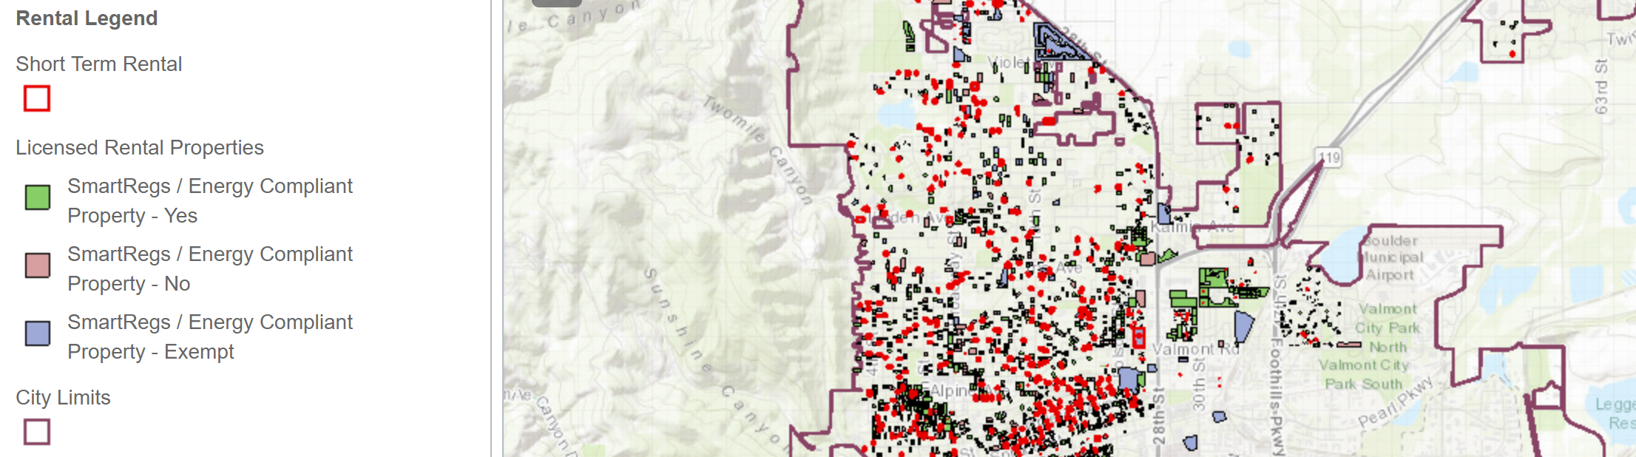
Boulder’s SmartRegs program publicly discloses which rentals are compliant, non-compliant, or exempt

Slide 29
Addressing Affordability

Slide 30
How will this policy impact affordability?
Landlord Protected Financially
Market Rate
Affordable for All
LIHTC,
Rent Controlled
Tenant Financial Risk
Tenant Protected Financially
Landlord Financial Risk
Notes:
Alisa run

Slide 31
What reduces the financial burden?
Recognizing other financial benefits (i.e. tenant retention)
Efficiency projects tied to incentive programs (finance)
Efficiency projects tied to financing that spreads out cost over life of equipment (finance)
Set efficiency target that can be achieved cost effectively (implementation)
Cap on efficiency project cost (compliance)
Efficiency of home is transparent (disclosure)
Notes:
Alisa run

Slide 32
Affordability ideas?
LIHTC | Rent Controlled | Market Rate/Short Term Rentals
Utility allowance | Enact policy to increase rent by 80% of energy savings or cost of implementation (whichever is lower) | Market forces/ competition Financing options: PACE, utility on-bill financing, green banks Guidance to landlords
Notes:
Alisa run. Open up for discussion

Slide 33
A well designed policy will account for the complexity of affordability
Key:
Primary takeaways
Direct influence
Inverse influence
Variable influence
Total Cost of Living
(TCL)
Decreases
LL = Landlord
TCL = Total Cost of Living
Energy savings
2. TCL should be the key focus, not rent. And the key is to keep it even or shrinking, not growing in order to avoid displacement.
1. Sufficient energy savings are crucial to keep TCL down
Rent
Increases
Stable Tenants / Tenant Retention
3. The threat of poor tenant retention is a primary driver in preventing rent increases – but more so in markets with low housing demand.
LL Profit
Upgrade cost
Also note:
5. Financing access is especially important for LMI landlords
6. Even if TCL stays steady, increased rents typically increase security deposits which reduces housing access
4. Finding other mechanisms to keep LL profits steady can help prevent rent increases – one of the most important strategies here is making sure that landlords understand that the financial value of tenant retention is often greater than the value of rent increases.

Slide 34
How to design a solution that meets both landlord and tenant interests
Tenant Interests Shared Interests Landlord Interests
Total Cost of Living
(TCL)
LL Profit
Rent
Energy Cost Savings
Security Deposit
Stable Tenants
Energy Upgrade Costs
Solutions that meet both party’s interests:
Value of stable tenants is greater than value of raising rent, maintaining both profit and TCL improvements without increasing rent.
Energy upgrade costs are spread over multiple years so that value of stable tenants and/or low rent increases retain or improve profits while TCL goes down.

Slide 35
Boulder hasn’t seen a rent increase as a result of their SmartRegs Policy
Source: https://www.deptofnumbers.com/rent/colorado/boulder/

Slide 36
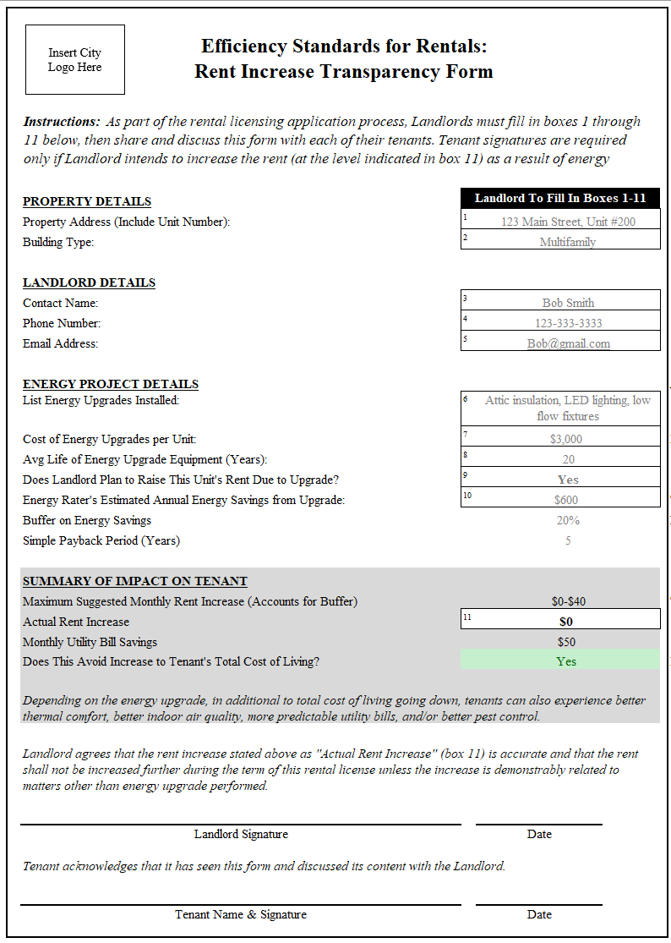
RMI created a template to make any rent increases transparent to tenants and the city
Source: https://www.deptofnumbers.com/rent/colorado/boulder/

Slide 37
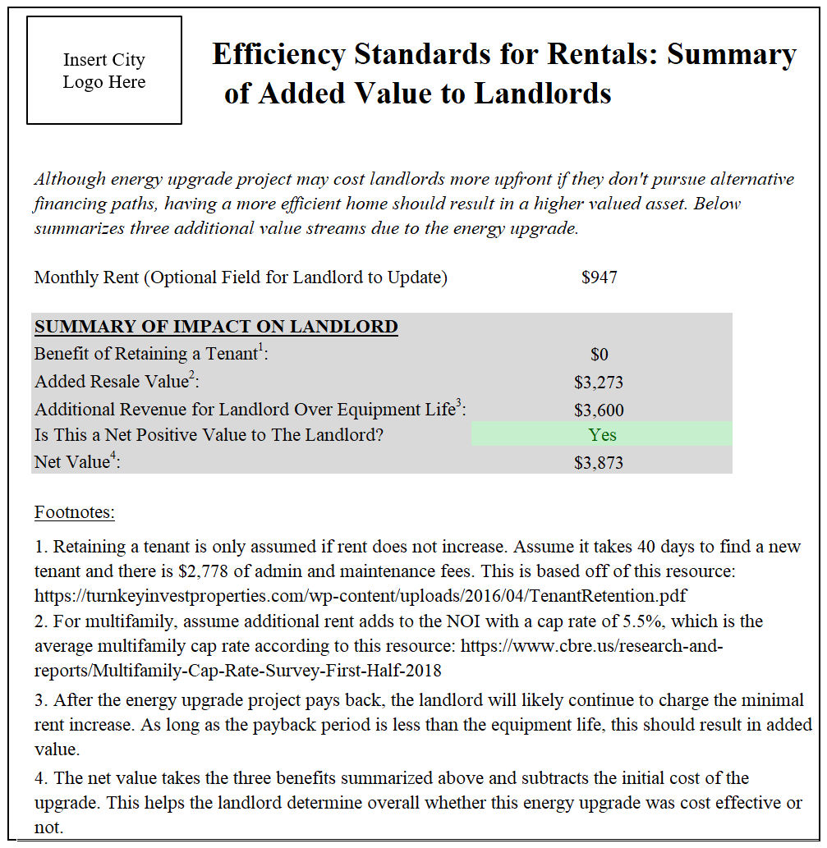
This tool also builds a business case for landlords on how this policy actually improves the value of their rental

Slide 38
What are some of the problems this affordability tool helps address?
Transparency prevents landlords from blaming massive rent increase on efficiency standards policy
Rent increase is separated out, and therefore could be seen as an "energy charge" instead of base rent increase. Viewing it this way may help to not increase the security deposit.
Opens dialogue between landlords and tenants around energy use. If the energy savings are greater than rent increase, this could make the rental more appealing to future tenants.
Shows landlords there is value to their energy upgrades.
Could help inform city policy around cost caps and financing tools that could improve affordability.
This allows cities to understand how rents are changing based on the policy and gives them the ability to correct issues in real time

