Slide 1

Preliminary Strategy Summary Supporting Fort Collins’ Climate Action Plan
Originally distributed to City of Fort Collins by RMI on October 13, 2014
Vehicle miles traveled A
Electric vehicles B
Distributed solar C
Building energy efficiency D
Fuel switching E
Demand response F

Slide 2
Summary
This document includes a high level summary of strategies that can be used to achieve a greenhouse gas emissions reduction goal of 80% by 2030 (2005 baseline) in the city of Fort Collins.
This goal (80% reduction by 2030) was identified through the “Stepping Up” analysis, conducted by Rocky Mountain Institute on behalf of Fort Collins Utilities, to assess the techno-economic potential for reducing greenhouse gas emissions in the city of Fort Collins.
Strategies were formulated through extensive expert solicitation, including national industry and subject matter experts as well as Fort Collins city staff.
For each of the strategies a few tactics were identified, based on expert feedback, that would be most effective for Fort Collins. Full tactic descriptions can be found in a separate document titled “Fort Collins CAP Tactic Descriptions.xlsx.”
In this document, we present the list of experts consulted and a breakdown of envisaged emission reductions by individual tactics.
These findings are preliminary and were conducted to inform the City of Fort Collins’ independent Climate Action Plan assessment and implementation planning.
The strategies that RMI studied are:
  Vehicle Miles Traveled (VMT) Reduction
  Increase Electric Vehicles (EV) Adoption
  Increase Distributed Solar Photovoltaic (PV) Adoption
  Boosting Building Energy Efficiency (EE)
  Encourage Fuel Switching (FS)
  Implement Demand Response (DR) Measures

Slide 3
FUNDAMENTALS OF SCALING
While there is a growing body of knowledge around ways to improve customer adoption across all six subsectors researched, Fort Collins’ accelerated adoption goals are unprecedented. Our expert consultations focused on identifying the most promising tactics for achieving scale by 2030. Across the board, we synthesized the following fundamentals to scaling by 2030.
To make the biggest difference quickly: Identify and target the biggest users
To speed individual adoption: Leverage the few who impact and influence the many
  (e.g. In the case of Fort Collins, Fort Collins Utilities, Colorado State University, employers, industry organizations, building portfolio owners, corporate fleet operators)
  Target expected population growth and associated development to build it right the first time
  (e.g. improved health and comfort, affordable housing, job growth)
Piggyback on events that are already planned
  (e.g. new build design and permitting process, lease renewal, renovations, equipment replacements, car sales)
Make it feel like a requirement, either through mandates or social norming
  (e.g. building code, voluntary or required disclosure and benchmarking)
  Take advantage of economies of scale to lower costs
Bundle offerings together to reduce customer acquisition costs and simplify customer interface
  (e.g. new build programs that bundle EE, DR, fuel-switching, PV and EV product offerings)
Promote local economic and other benefits the community already seeks
Build a sense of community
Create a sense of urgency to “act now”
  (e.g. social competition, limited time incentive offers)

Slide 4

A. Preliminary VMT goal, experts, guiding principles for scaling from Stepping Up Analysis
Stepping Up Goal: 30% reduction in vehicle miles traveled per person
(~ 396,000,000 VMT reduction from 2030 business-as-usual projections)
Experts consulted to date:
Aaron Fodge, Colorado State University
Adrian Guan, Intelligent Transportation Society of America
Amy Lewin, FC Moves
Bibiana McHugh, Portland TriMet
Craig Dubin, FC Moves
Dan Luxembourg, Bandwagon
David King, Columbia University
David Mahfouda, Bandwagon
Emma Belmont, TransFort
Jeff Maki, The Control Group, former project leader for BusTime NYC
Kevin Bell, Boulder’s B-Cycle Bike Share
Michael Manville, Cornell University
Susan Shaheen, University of California - Berkeley
Steve Bayless, Intelligent Transportation Society of America
Guiding principles for scaling:
Pre-condition for reducing VMTs:
  Multimodal alternatives must provide individuals the same or greater mobility (ability to get from point a to point b) at comparable cost and convenience to existing means
Leverage anticipated new builds/redevelopment to shape long lasting changes
  Either new neighborhoods or infill design
Leverage CSU campus and population
  Roughly 20% of entire community
Build on Fort Collins’ well-established biking identity and culture
  Voted Platinum by American Biking Association for most bikable communities)

Slide 5
A. Preliminary VMT Goals: bundle contributions to 2030 goal
2030 GOAL: Reduce VMT/person by 30% (396,000,000 VMTs avoided)
46%
Leverage new build and infill development
  2a. Reduce off-street parking requirements
  2b. Retrofit, charge for, and reduce on-street parking
  2c. Smart growth: new build
  2d. Smart growth: redevelopment of existing streets
38%
Move to a multimodal transportation system
  1a. Open transportation data
  1b. Mobile transit apps
  1c. Implement car and ride share
  1d. Implement bike share
  1e. Regionally-coordinated mass transit expansion
1f. Housing + Transportation Affordability Index tools
16%
Engage employers to address #1 source of VMTs (commuting)
  1g. Corporate engagement: alternative commuting
  2a. Reduce off-street parking requirements
Notes:
Leverage new build
Majority of Fort Collins residents also work in Fort Collins

Slide 6

B. Preliminary EV goal, experts, guiding principles for scaling from Stepping Up Analysis
Stepping Up Goal: 38,855 total EVs sold through 2030 [~50% of all new vehicle sales (not including trucks) are EV]
Experts consulted to date:
Sarah Olexsak, DOE Workplace Charging Challenge
Shannon Shea, DOE Clean Cities Initiative
Maria Eisemann, Northern Colorado Clean Cities
Paul Sizemore, FCMoves
Michael Brylawski, Charlie Bloch, Vision Fleet Capital, Inc.
Guiding principles for scaling:
Provide functionality, safety, performance, and convenience for a comparable cost.
Address 2 biggest barriers: cost (total vs. sticker) and deficiencies in infrastructure.
Proportion of Colorado State University population compared to entire community (~20%) makes them a good leverage point.
Leverage projected growth and accompanying master planning opportunities for long lasting formative changes. Build it right (EV-ready) from the start.

Slide 7
B. Preliminary EV Goal: bundle contributions to 2030 goal
2030 GOAL: 1 in 2 car sales is electric (39,000 EV car sales)
17%
Electrify commercial fleets
Commercial
Fleets
  3a. Fleet electrification
16%
Expand EV infrastructure
4a. EV Exposure Campaign
4b. EV Infrastructure
4e. Upstream dealership programs
67%
Increase exposure to EVs and address up front cost
4a. EV Exposure Campaign
4c. Rebates/Incentives
4d. Aggregate EV Purchases
4e. Upstream dealership programs
4f. TOU Pricing and Utility Programs
4g. Battery Exchange Pilot
4h. Tax Policy
4i. EV Apps
Individual Adoption
7
Notes:
Baseline is key. Assume 16,000 already from baseline.
2013 Frost and Sullivan study: Fleets account for 50% of EV purchases today nationwide.

Slide 8

C. Preliminary PV goals, experts, guiding principles for scaling from Stepping Up Analysis
Stepping Up Goal: 312 MW of solar resources installed locally in Fort Collins
Experts consulted to date:
Steve Catanach and Norm Weaver, Fort Collins Utilities
Jesse Morris, Rocky Mountain Institute
Jon Sterling, Solar Energy Power Association
Wendy Serour and Tiana Smith, Fort Collins Utilities-ClimateWise
Vincent Hoen, EcoFYS
Bruce Dickenson, SunPower
Toni Bouchard, SmartPower
Ben Foster, Optony
Dan Seif, Butler Associates
Tom Puttman, Puttman Associates
Cisco Devries, Renewable Funding
James Tong, Clean Power Finance
Bryan Garcia, Bert Hunter, Mackey Dykes, Clean Energy Finance and Investment Authority (CT Green Bank)
Guiding principles for scaling:
Crucial precondition: an airtight economic value proposition that makes owning, investing in, or supporting a PV system immediately cost-effective to customers
Policy removing all permitting, inspection and interconnection costs
Aggregation to ensure economies of scale in customer acquisition and install costs
Leverage the utility’s unparalleled access to individuals and businesses
Piggyback on anticipated new build, expected from high population growth, to build solar PV cost effectively and efficienctly the first time
Drive demand through targeted sales programs for both residential and commercial customers with the appropriate financing tools in place to streamline transactions

Slide 9
C. Preliminary PV Goal: bundle contributions to 2030 goal
2030 GOAL: 312 installed MW of local PV
~367 MW potential
73
Existing commercial
5a. Comm. Integrated Utility Services (IUS)
“Independent” Commercial
51
New build commercial
4a. New build commercial PV reqs
108
Existing residential
~ 200 MW potential
3c. Big-box Partnerships
102
Utility-owned, locally sited
3a. Resi Integrated Utility Services (IUS)
Ground mount:
1a. PRPA-owned, rate based OR
1c. PRPA-owned, community solar
“Independent” Residential
100
134
New build residential
2a. New build residential PV reqs
100
Roof top:
1b. PRPA-owned, rooftop PV
Utility-owned tactics overlap w/ Independent tactics

Slide 10
Concept Design - distributed solar 1a and 1c: prpa-owned ground mount models
Entire Community (homes and businesses) *
* Motivated to consume less to stay within cheaper first rate block.
Includes tax equity, utility equity, municipal bond financing, and/or bank debt
Rate-based retail prices for energy. First block of rates is cheapest and supplied by solar.
Energy
Private Investor
Project capital
PRPA-owned local generation asset
FCU
Wholesale prices
for energy
Project capital interest
1a. Utility-owned, locally-sited ground mount solar: energy is rate-based and benefits the entire community.
Subscribed homes and businesses only *
* Receives a credit if consumes less than pre-purchased block amount.
Includes tax equity, utility equity, municipal bond financing, and/or bank debt
All electricity consumed billed at pre-established community solar purchase price.
Energy
Private Investor
Project capital
PRPA-owned local “Community Solar”
FCU**
Collected price for energy less distribution costs
** Facilitates billing and charges some distribution fee.
Project capital interest
1c. Utility-owned, “community solar”: energy is priced at retail block rates as per purchase agreement, to subscribers only.
1c. Utility-owned, “community solar”: energy is priced at retail block rates as per purchase agreement, to subscribers only.

Slide 11
Concept Design - distributed solar 1b. prpa-owned, distributed rooftop pv
Energy
Energy
Energy
PRPA
Home
Business
Industry
Project
capital
interest
Energy
Utility bill
Utility bill
Utility bill
Project capital
Energy
Energy
Energy
FCU
Private Investors
PPA for distributed resource generation
Includes tax equity, utility equity, municipal bond financing, and/or bank debt

Slide 12

D. Preliminary EE goal, experts, guiding principles for scaling from Stepping Up Analysis
Stepping Up Goal: 31% reduction in buildings’ total energy use
  (~4.83 TBTUs in energy use reductions across Fort Collins building stock)
Experts consulted to date:
John Phelan, Fort Collins Utilities
Kendra Tupper, City of Boulder
Caroline Traube, McKinstry
Laura Hutchins and Jonathan Kleinman, Clear Result
Ric Cochrane and Jeana Weiser, National Trust for Historic Places
Travis Estes, Next Step Living
Patrick MacRoy and Peter Ludwig, Elevate Energy
Jordana Cammarata and Marisa Ceppi, FirstFuel
Rob Harmon, EnergyRM
Cisco Devries, Renewable Funding
Matthew Brown, Harcourt Brown & Carey’s
Ruben Munger, Vision Ridge Partners LLC
Bill Campbell, Equilibrium Capital
Bryan Garcia, Bert Hunter, Mackey Dykes, Clean Energy Finance and Investment Authority (CT Green Bank)
Guiding principles for scaling:
Hand hold the customer through the process with a limited number of interactions and a streamlined delivery process
Provide flexible financial products
Most effecitve policies include enforcement
Incent performance based contracting to ensure savings
Enable behavior change through education
Aggregate projects and streamline transaction processes

Slide 13
D. Preliminary EE Goal: bundle contributions to 2030 goal
2030 GOAL: 30% less building energy consumption from EE (4.83 TBTU)
Existing commercial
1.70
Other:
5b. Work with upstream vendors
4h. Energy efficiency municipal operations
4m. Target top 15 commercial portfolio owners
4n. Deep engagements with industrial facilities
Commercial
4i. Commercial Integrated Utility Services (IUS), bundled w/
4j. Metered Energy Efficiency Transactions (MEETS)
4l. My 80x30 public awareness and education campaign
4k.Commercial PACE
_{1.1}
New build commercial
.17
3a. Building codes- residential
5a. Contractor engagement and training programs
2.42
Existing residential
Other:
2c. Work with upstream vendors
2a. Rental license trigger
Residential
2b. Residential Integrated Utility Services (IUS), bundled w/
2c. Address condominium barriers
2d. My 80x30 public awareness and education campaign
2e. Employer Wellness Program Financing
_{2.25}
.94
New build residential
1a. Building codes- residential
5a. Contractor engagement and training programs
5.23 TBTU potential
Notes:
Other: distinct segments
IUS: drive adoption on general small to mid commercial

Slide 14
Concept Design - energy efficiency 2b. residential ius model for energy efficiency
Tariff funds
Utility bill w/ tariff
(total bill equal to before,
or reduced)
Home Performance Contractor
Home Owner
Utility
EE concierge service
Energy (less)
Payment for services
Program
capital
interest
Program
capital
ECM installation
Subs
Private Investors

Slide 15
Concept Design - energy efficiency 4j. commercial meets model for energy efficiency
Commercial Property Owner
Pays owner for right to install ECMs and to harvest negawatts
Buys negawatts, along with watts
Accrued negawatts
Sells negawatts, along with watts
Energy Service Company
Accrued negawatts
Utility
Pays for negawatts
Project
capital
interest
Project capital
Private Investors

Slide 16
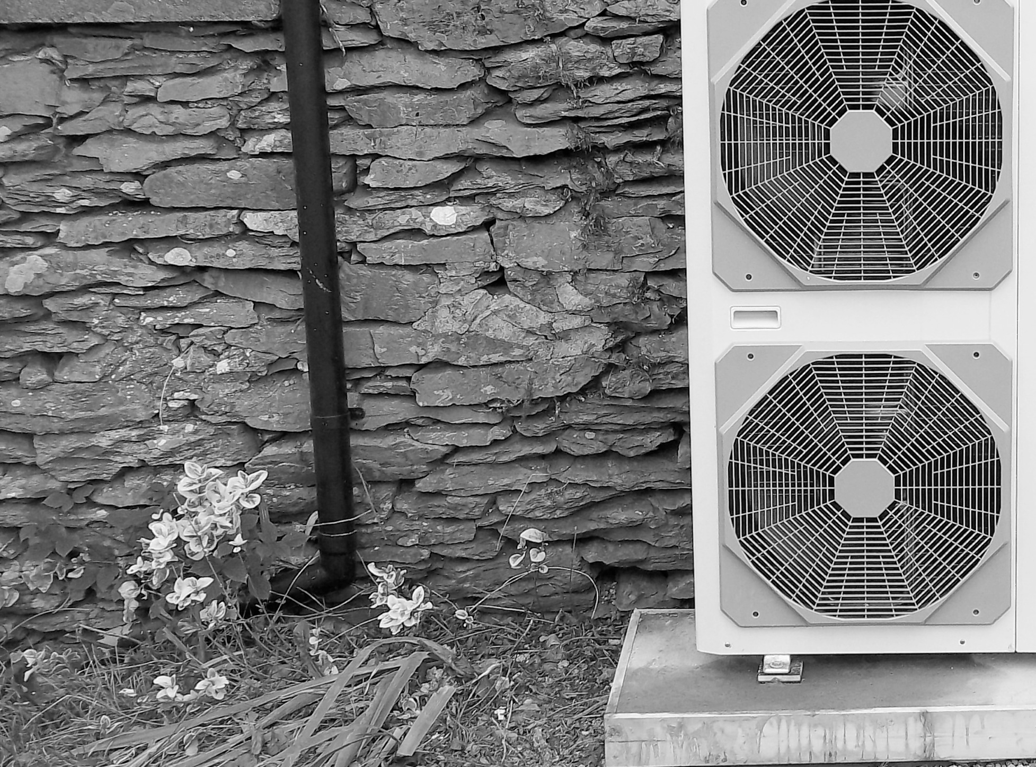
E. Preliminary FUEL SWITCHING goal, experts, guiding principles for scaling from Stepping Up Analysis
Stepping Up Goal: Eliminate lingering fossil fuel consumption by fuel switching to electricity.
Avoid 1,777,442 MMBTU natural gas by 2030 by targeting nat gas consumption in buildings
Experts consulted to date:
Travis Estes, Next Step Living
Laura Hutchings (Populus) and Jonathan Kleinman, CLEAResult
Josie Plaut, Institute for the Built Environment
Eric Harrington, Harrington Construction LLC
Caroline Traube, McKinstry Construction
John Phelan, Fort Collins Utilities
Guiding principles for scaling (focused largely around fuel switching for space heating:
Leverage value to utility from increased electricity revenue.
Leverage projected growth to cost-effectively fuel switch from the start (build all-electric or district heating).
Provide comfort, heating and cooling with one piece of equipment for a comparable cost.
Address barriers including upfront equipment and installation cost, low cost of natural gas over lifetime (e.g. fuel switching provides a hedge against natural gas price volatility).
Target key market segments: homeowners that want to install central AC, homeowners that do not want combustion on-site, existing buildings with furnaces up for replacement or under renovation, commercial buildings at lease handover.
For super-insulated homes, electric resistance could be the most economical and environmentally sound choice

Slide 17
E. Preliminary FUEL SWITCHING Goal: bundle contributions to 2030 goal
Commercial and Industrial Campuses
2030 GOAL: Avoid 1.75 million MMBTU of natural gas
7%
  3a. Gasless or biogas campuses
25%
Residential new build
  1a. Residential utility all-electric and fuel switching programs
  1b. Leverage homebuilding network to build all electric homes
  1c. Renewable thermal standards and/or codes for new residential builds
  1d. District heating for residential
New
Buildings
22%
Commercial new build
3%
2a. Commercial renewable thermal standards and/or codes
68%
Residential existing
  1a. Utility all-electric and fuel switching programs
  (close to 1 in 3 existing homes fuel switch)
Existing Buildings
66%
Commercial Existing
2%
  1a. Utility all-electric and fuel switching programs
17
Notes:
Residential takes a lot of the action – growth, and then ease of replacements vs. specific commercial needs.
New – all electric
Decreases burden on existing (used to be 1 in 2, now 1 in 3)

Slide 18
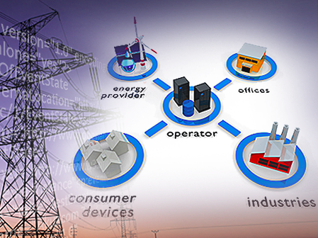
F. Preliminary DEMAND RESPONSE goal, experts, guiding principles for scaling from Stepping Up Analysis
Proposed goal: 60MW of peak reduction and demand response load by 2030.
Based on bottom-up analysis of BAU peak demand patterns. Potential to be revisited after scenario(s) has been drafted to consider impacts from EE, fuel switching and EV loads, as well as to size DR impact on costs.
Experts consulted to date:
Pablo Bauleo, Fort Collins Utilities
John Phelan, Fort Collins Utilities
Steve Catanach, Fort Collins Utilities
James Tong, Clean Power Finance
John duPont, EnerNOC
Ake Almgren, PJM Interconnection
Simon Baker, California Public Utility Commission
Tim Stout, E Source
Peter Zschokke, National Grid
Guiding principles for scaling:
For Program Design:
Integrate: Benefits are only fully captured when DR can be integrated into grid operations as firm capacity and flexible operating reserves.
Design in flexibility: Design adaptive DR programs which will minimize the need for subsequent roll-outs. As the electricity system evolves (i.e. more EVs and intermittent renewable energy) using DR to more closely match demand with generation will drive down costs. Today’s roll-out strategy needs to consider what these future needs will be.
Price signals are key: The structure for how “costly peaks” are passed from the system to the utility should determine which DR programs are deployed. The monetary exchange between PRPA and FCU needs to accurately reflect the true cost to serve the system.
For Customer Participation:
Make it Flexible: Every customer will have their own needs and preferences, so there should be many options for DR program offerings. Work with customers to understand their needs and develop solutions collaboratively while still serving the larger system.
Make it Easy: Make sure it is simple for the customer to participate in order to have sustained performance of programs. Try to design the “human out of the loop” (deploy IT intelligently to make it quicker and easier for customers to respond).

Slide 19
F. Preliminary DEMAND RESPONSE Goal: bundle contributions to 2030 goal from Stepping Up Analysis
2030 GOAL: 60MW of peak reduction from BAU in 2030 from Demand Response interventions.
63MW potential
50%
Existing residential
4c. Residential Integrated Utility Services (IUS), bundled w/
4b. Existing residential rate adoptions
Residential
32 MW
12%
New build residential
4a. DR-ready new builds
7MW
36%
Existing Commercial and Industrial
6a. Large C&I deep engagements
Commercial & Industrial
Small-to-mid commercial bundle:
23MW
5a. Commercial Integrated Utility Services (IUS), bundled w/
5b. Aggregation of small commercial
5c. Mandatory rate adoption
2%
1MW

